Slide 1
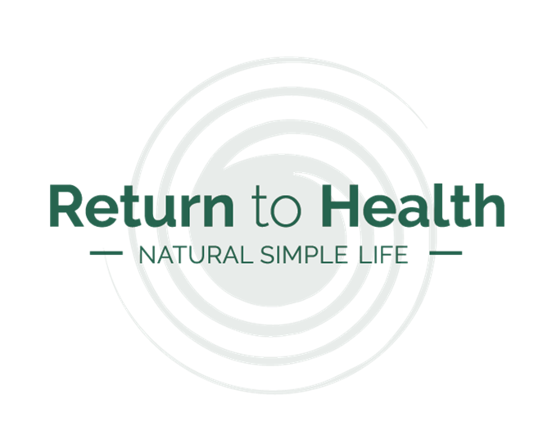
Professional Modern Homeopathy
Module 2: Basic Human Physiology

Slide 2
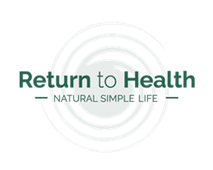
General Guidance
Your books are REFERENCE MATERIALS, therefore you are not expected to read them cover to cover, but rather delve in and out as needed. Do get to know them, their structure and general content, apply mark-up and add your own notes – they should become extensions of you and your knowledge, both during your studies and beyond, as part of your clinical practice.
The term “READ” is often used in your modules: in this context you are required to read once with attention, with the aim not to retain all the information, but have a general awareness of the content and its location for future reference.
The term “STUDY” is often used in your modules: in this context you are required to conduct an in-depth study of the information with the aim to learn and retain it for future practical use.
The term “RESEARCH” is often used in your modules: in this context you are required to search through all your materials, reference books and the internet in order to obtain a wide and multi-facetted view of the research topic, that includes not only the Homeopathic viewpoint, but also other Alternative Modalities’ views and that of Western or allopathic medicine.
The term “COMMENTARY” is often used in your modules: in this context you are required to comment on the breadth of your research, compare and contrast the views and finally draw your own conclusion(s). Your own conclusion denotes your personal viewpoint or commentary on the topic.
As part of each assignment, students must include a full BIBLIOGRAPHY as an appendix to their work, referencing each published work, internet resource or other sources of information consulted during the construction of their assignment. Entries should include the work’s full title, author, publication dates and version number, where applicable.
Each module is considered “COMPLETED” once the module assignment is successfully passed by your teacher; you have between 1 and 3 months to complete the module and your target completion date must be discussed with your teacher upon receipt of each module.
The term “SOURCE” is often used in your modules: in this context the term refers to a central, infinite energy to which all forms of life are connected and through which all energy cycles according to its natural laws. Students with specific religious frameworks may read this term as per their relevant denomination.

Slide 3
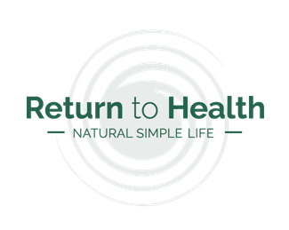
Module Content
Section A: Classroom Instruction
Basic Anatomy
General structural overview
General energetic overview
General holistic overview
Major Systems and Functions
Nervous System, including Brain
Cardiovascular System, including Blood
Respiratory System
Musculoskeletal System
Gastrointestinal System
Lymphatic System
Endocrine System
Urinary System
Reproductive System
Sensory System
Basic Pathological Processes
Homeopathic view of pathology
Section B: Student Research
Read the prescribed texts as set out in detail on the module slide
Section C: Module Assignment
Complete the prescribed assignment tasks and return to RtH for marking.
Section D: Clinical Practice
Not applicable for this module.
Section E: Module Feedback
Student Feedback
Teacher Feedback

Slide 4

Learning Outcomes
On completion of this module, students should have –
A general understanding of the primary structure and functions of the physical body.
An understanding of where to obtain more detailed physiological information when required.
A broad appreciation that Homeopathy does not separate or isolate the physical body, from the mental, emotional or spiritual aspects for the human being, and that all levels are taken into account when assessing a case.

Slide 5
Terminology
“Anatomy” – the study of structure and relationships between systems.
“Physiology” – the study of how systems function and integrate with each other.
“Pathology” – the study of abnormalities and how this effects physiology, anatomy and overall wellbeing.
“Energetic or Mental Body” – the non-physical energy within the person which is responsible for the emotions, decision-making process and mental wellbeing.
“Auric or Spiritual Body” – the non-physical energy extending beyond the skin boundary, connecting the person to their surroundings, other people and Source.
“Yin / Yang” – in Traditional Chinese Medicine (TCM) these terms are used to represent to opposite and interdependent energies, both needed to sustain life. No one can exist without the other and an imbalance of one results in an equal and opposite imbalance of the other. Yin = shadow, dark, feminine. Yang = light, bright, masculine.
“Vital Force” – also referred to as Qi in TCM – the unseen force that animates and perpetuates life in organic beings. For the purposes of this course, Vital Force is considered to be connected to Source from where it originates and to where it returns.

Slide 6
Section A: Classroom Instruction
Part i – Basic Anatomy

Slide 7
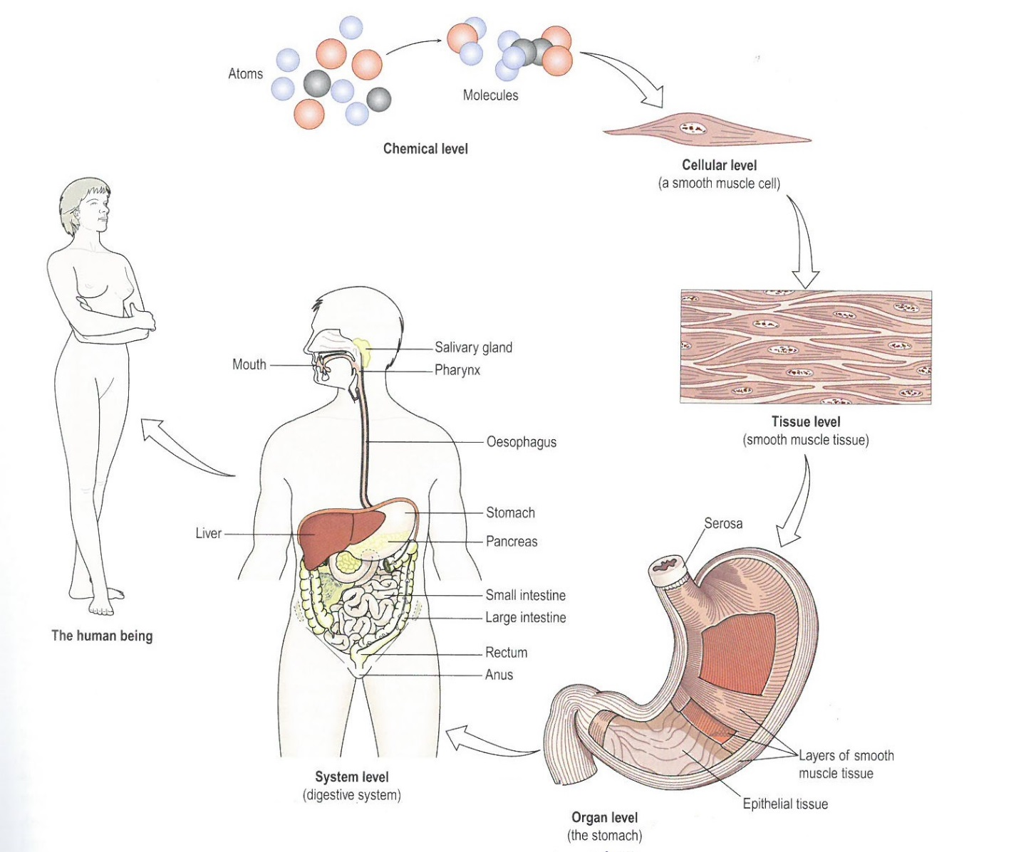
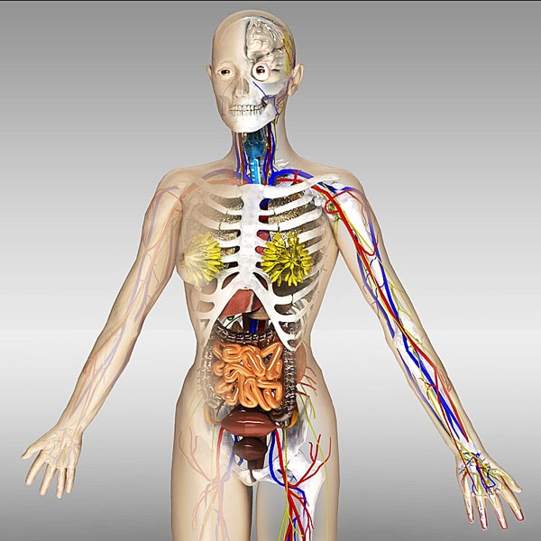
General Structural Overview
(auric level / spiritual level
Sensory System
Auric / Spiritual System
Endocrine System
(energetic level / mental level)
Energetic / Mental System
The Vital Force
Respiratory System
Immune System
Musculoskeletal System
Lymphatic System
Cardiovascular System
Nervous System
The Skin
Gastrointestinal System
(physical level)
Reproductive System
Urinary System
Notes:
Homeopathy considers the person as a “whole” consisting of the physical body, the mental / energetic body, the spiritual / auric body and their respective, constituent parts. Coursing through the whole is the Immune System, the Vital Force and the Love: the power that connects the whole person to the whole of the universe. Therefore no one aspect of the whole person can or should be separated from another part, or indeed from their surroundings, families or experiences. Doing so attempts to separate and isolate individuals or their symptoms from the wider energetic web in which they live, and therefore removes the context within which treatment should be given.

Slide 8
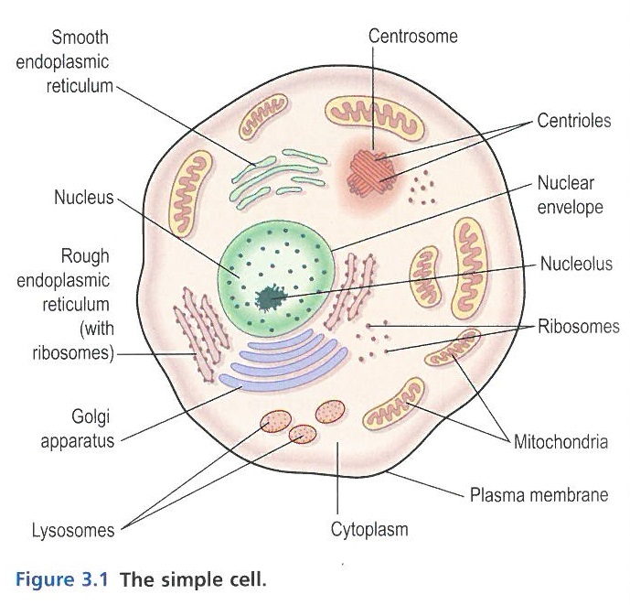
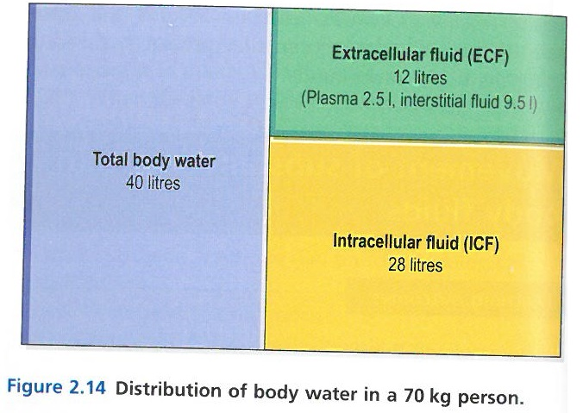
General Structural Overview
Just as Homeopathy is concerned with FLOW, it is important to know that water and fluidity is at the root of life. Not only is 71% of our planet, water, but 60% of our bodies is water, with a further 20% consisting of various types of fluid such as plasma.
“Being in the Flow”, therefore takes on significant meaning when considering our physical, emotional and spiritual health, and it is all present in the simple cell.

Slide 9
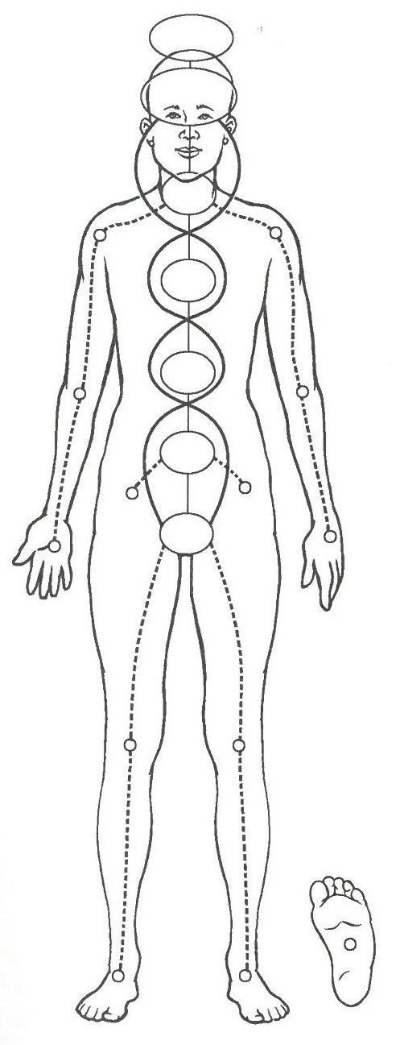
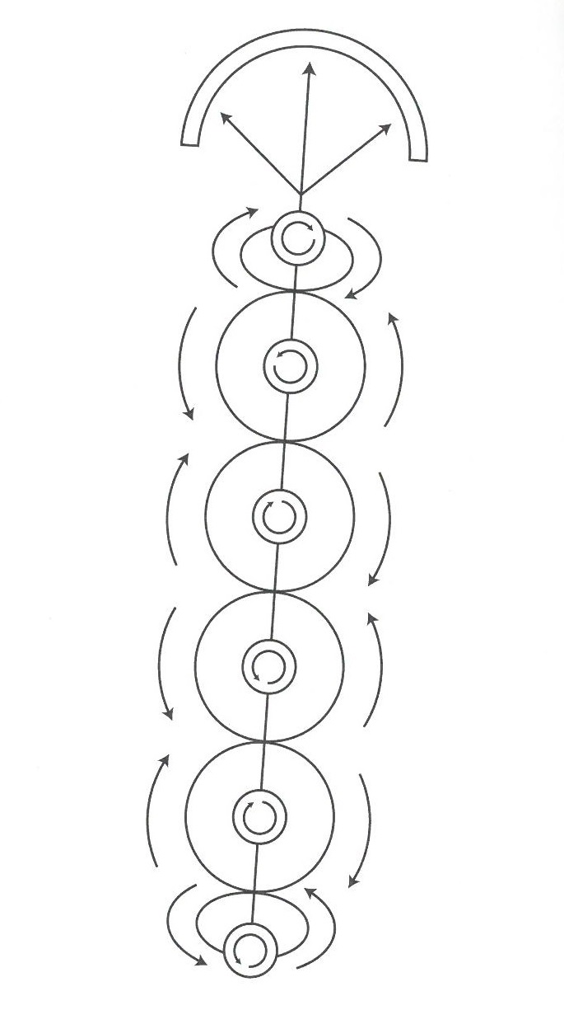
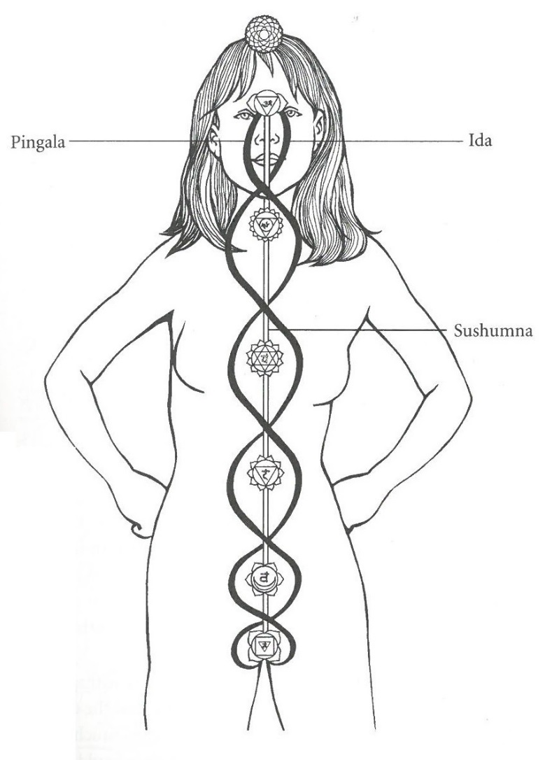
General Energetic Overview
The spinning action of each chakra creates an energy current that is symbolically well-recognised in the CADUCEUS – adopted emblem of the mainstream medical system. This current consists of Ida (the liberating current travelling upwards in a pull from the Mind and Spirit), and Pingala (the manifesting current travelling downwards in a pull from Body and Soul). The current cross the Midline, called Sushumna and for our purposes, ,considered the core of the Vital Force.
There are many, many chakra points both within and without the physical body. The diagram on the left depicts the major and minor chakras mostly encountered in homeopathic healing, and the connecting pathways between them, called Nadis.
Chakras are energy nodes spinning in a multi-dimensional manner (a vortex), allowing the connection to, and flow-through of, the Vital Force between the physical and non-physical planes.
Notes:
Homeopathy is in essence an energetic medicine. As discussed in Module 1, the underlying premise of homeopathy and many other natural and holistic modalities, is energy, and how this can be distorted by factors internal and external to the person. We will learn in later Modules how exactly homeopathic energy is derived, used and its curative effects. In this module please consider the fact that energy cannot be created nor destroyed by human hand; it can be derived, manipulated, directed, used and changed, but ultimately energy can only change form from one state to another.
This then brings to mind the FLOW of energy, or the way it is used and changed, and where it can get stuck or become deranged. It is therefore very important for a homeopath to always consider the energetic flow being observed: this flow of energy is visible through the physical, mental & emotional, and spiritual bodies and is the essence of health and healing.

Slide 10
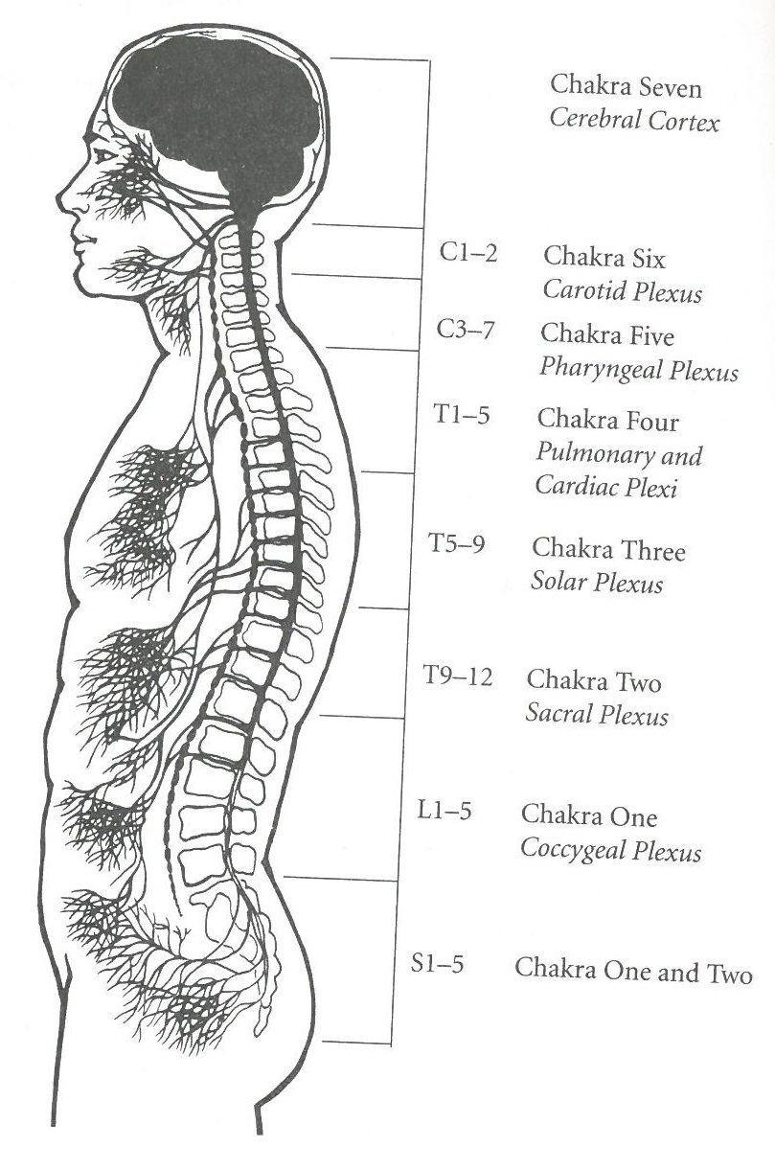
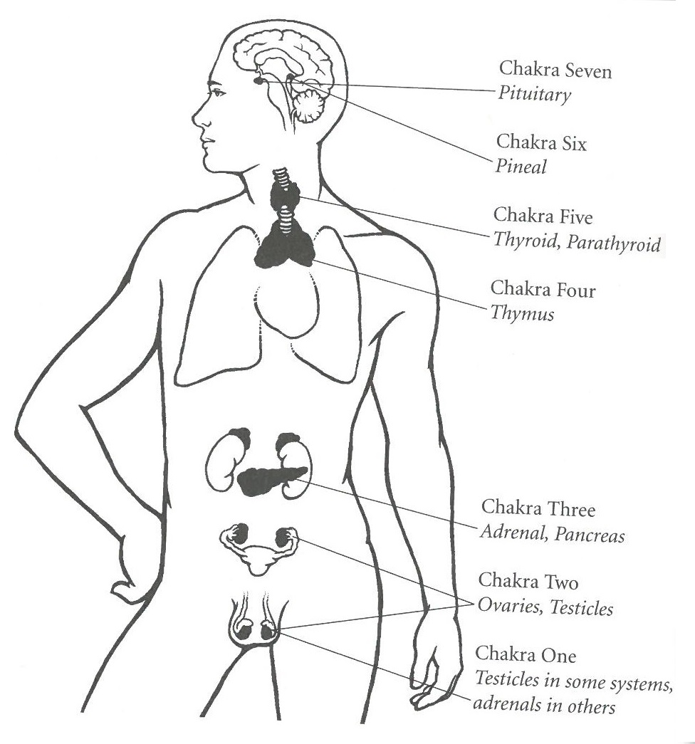
General Energetic Overview
From a physiological view point, the energy flowing through and between chakras, and travelling along nadis, has a direct bearing on the health and function of the corresponding organs and systems.
The diagrams on either side depict how the chakras map to the cerebro-spinal column, the nervous system and the endocrine systems – three of the main systems involved in overall physical and mental health.
When therefore considering illness and health from a homeopathic viewpoint, we incorporate the energetic view, considering where flow may be impacted and how health can be restored.
Notes:
Homeopathy is in essence an energetic medicine. As discussed in Module 1, the underlying premise of homeopathy and many other natural and holistic modalities, is energy, and how this can be distorted by factors internal and external to the person. We will learn in later Modules how exactly homeopathic energy is derived, used and its curative effects. In this module please consider the fact that energy cannot be created nor destroyed by human hand; it can be derived, manipulated, directed, used and changed, but ultimately energy can only change form from one state to another.
This then brings to mind the FLOW of energy, or the way it is used and changed, and where it can get stuck or become deranged. It is therefore very important for a homeopath to always consider the energetic flow being observed: this flow of energy is visible through the physical, mental & emotional, and spiritual bodies and is the essence of health and healing.

Slide 11
General Holistic Overview
Please refer to the latest version of Holistic Overview of Whole Person Energy, located in the Library on your student Teams site.

Slide 12
Section A: Classroom Instruction
Part ii – Major Systems and Functions
Notes:
In considering basic human physiology, Homeopathy is especially interested in two key aspects: FLOW and BALANCE.
Flow, as in the fluidity of the human body, its excretions, lymphatics, distribution is paramount to healthy transmission of energy and when it is blocked or deranged, there will be health consequences. Homeopathy of course also considers the “bodies” beyond the physical: the emotional body, the mental body, the spiritual body. FLOW is as relevant here as in the physical body – more so in our view – and blocks or derangements here will equally impact the client.
Balance is what we think of as equilibrium, a sustainable, organic ecosystem that ebbs and flows according to natural processes, however maintains a balance such that overall wellbeing is general maintained. Please note this is NOT “homeostasis” as viewed in allopathy – which aims to achieve a static, unchanging state it considers balanced. This is simply not relevant nor desirable in an organic being. We need to consider the client as a complete ecosystem, in which balance is maintained over a long period of time.
So in working through the Major Systems and Functions part of this module, please bear in mind Homeopathy’s love of FLOW and BALANCE, and their roles in overall wellbeing.
As we now progress with Part ii – we will be focusing primarily on the PHYSICAL body, as a basis for further homeopathic study wherein we expand very much beyond this. Please bear in mind that though we now talk primarily of the physical (Body) aspects, there are ALWAYS the energetic (Mind) and spiritual (Soul) aspects to take into account.

Slide 13
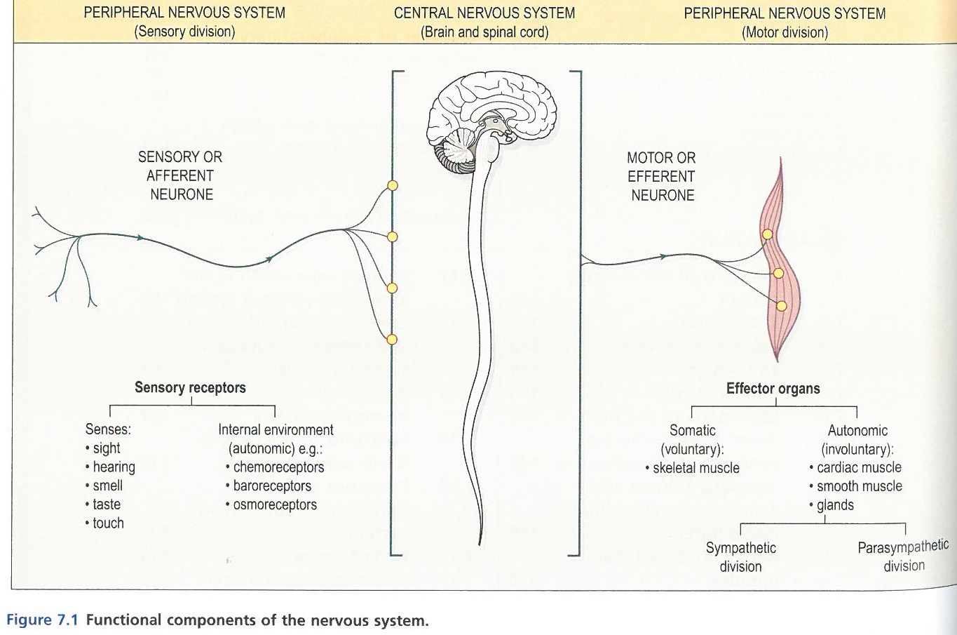
Nervous System, incl. Brain
The Nervous System, which includes the Brain, is the electrical super highway of the body. The cells and tissues are unique to the nervous system and consist of neurones, nerves and neuroglia – all with the unique and explicit function to send and receive electrical impulses which act as stimulus to the body.
The two key components of the nervous system are:
The Central Nervous System (CNS), which in turn encompasses the Brain, the Cerebral Spinal Fluid (CSF) and the Spinal Chord.
The Peripheral Nervous System (PNS), which in turn encompasses the Cranial Nerves, the Spinal Nerves, the Thoracic Nerves and the Autonomic Nervous System (ANS).
Together, these two key components permeate the ENTIRITY of the human body: all senses (of which we have arguably 21, not 5), all sub-systems such as the Endocrine System and the Musculoskeletal System and all related functions performed by these systems. There is not one single aspect of the total human function that is not connected by and communicated to, through the Nervous System (NS).
The NS does not fully mature until roughly the age of two, and even then many studies show the further nerval development is present during later developmental and adult years. This begs the question why we can so readily impact the NS through various lifestyle, health and medical choices, with little regard for the residual effect held within the physical body.

Slide 14
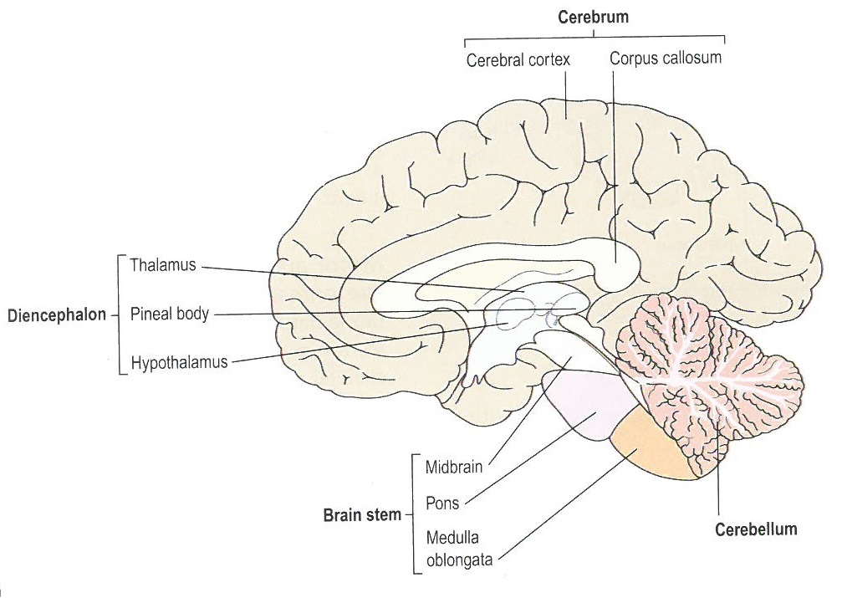
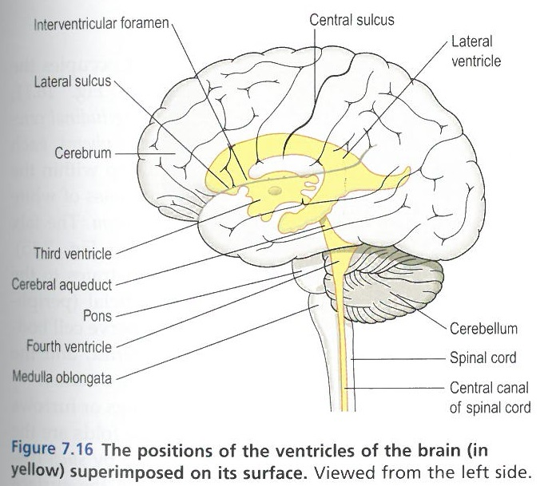
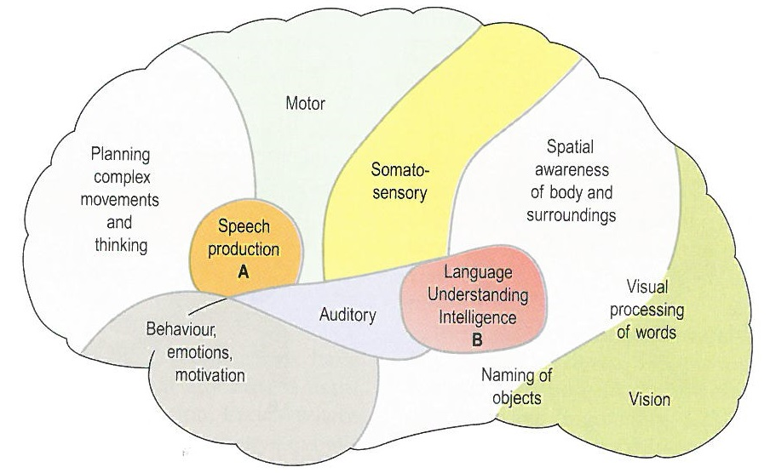
The Central Nervous System
The Brain, resembling a walnut in many ways, is a multi-layered, soft-tissue organ contained in the skull and floats in the CSF. In its ideal state the brain is buoyant and held loosely by the medulla oblongata to the rest of the spinal column.
(incl Pituitary Gland)
Notes:
Yogic texts refer to a “Rainbow Bridge” between the Pituitary and Pineal Glands, said to retain the core of Spiritual Consciousness and connection to Source. It is further believed that vaccination and other shocks to the nervous system destroys this delicate, energetic bridge, leaving the individual with an inability to readily make and maintain connection.
Also note the overlap between these endocrine glands and the cerebral functions of speech and understanding; two of the primary pathologies observed in autistic children.

Slide 15
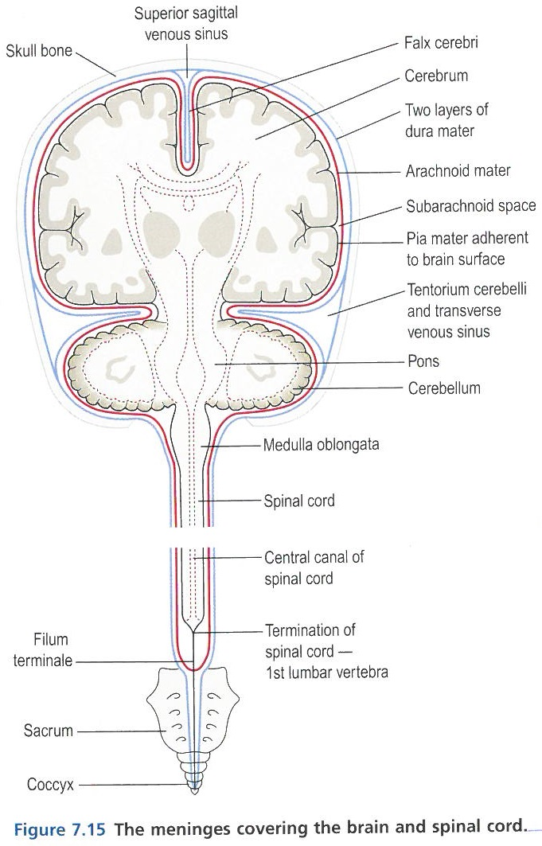
The Central Nervous System
Around the brain is a three-level membrane tissue known as the Meninges. They lay between the brain and the skull and are separated by CSF. The outer meninge (Dura Mater), is quite fibrous and protective. The middle layer (Arachnoid Mater) is also fibrous though less dense, and smooths over the undulations of the brain matter. The third meninge closest to the brain itself is the Pia Mater, permeated with a myriad of tiny blood vessels feeding the brain.
Dura Mater: the hard mother – though love or no love at all.
Arachnoid Mater: the spider mother – bonded or conditional love.
Pia Mater: the pious mother – providing love and autonomy.
The meninges are connected to the spinal column by passing through the medulla oblongata. Increased tension or pressure within these sensitive tissues, exerts an enormous force on the brain.
The CSF flows within the cranial space, between the brain, the meninges, throughout the spinal column and even interacts with the blood and other cell plasmas through osmosis and reabsorption. Its purpose is to maintain a consistent pressure around these sensitive organs and systems, absorbing shocks and insulating from unwanted forces. The CSF also keeps the soft tissues moist and finally, acts as a conductor for water, glucose, mineral salts, plasma proteins and more.

Slide 16
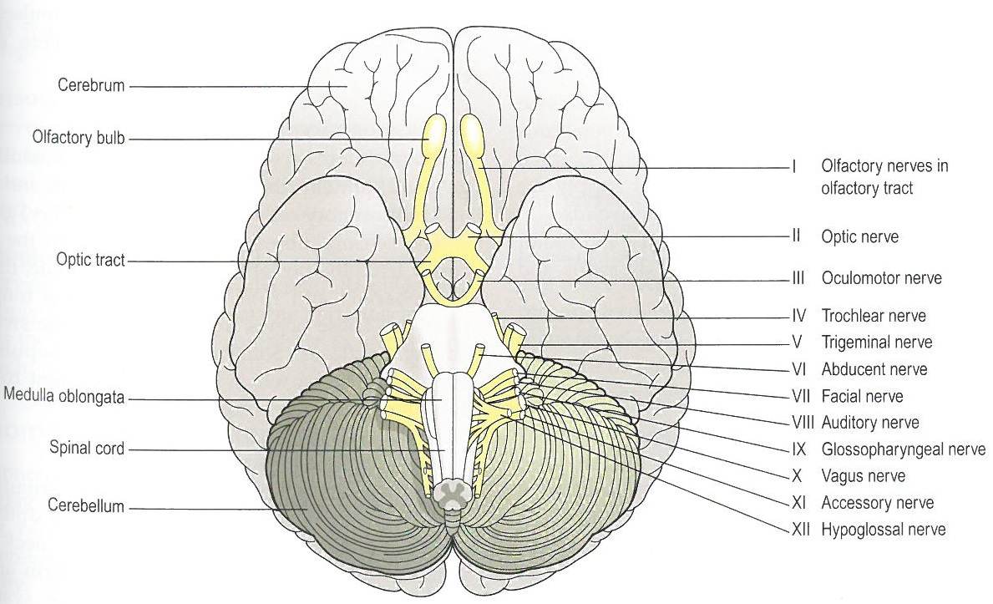
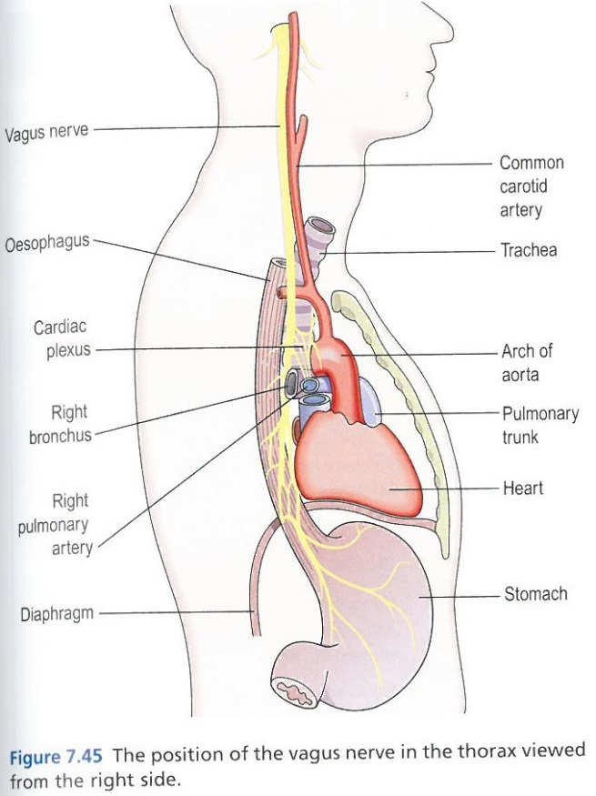
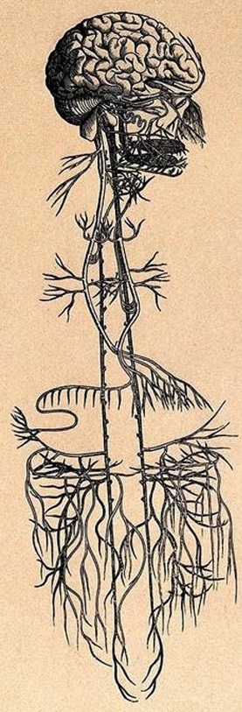
The Central Nervous System
The brain matter also contains the Cranial Nerves, each of which facilitates communication between the relevant cerebral function and its corresponding structure, e.g. the Optic Nerves connecting the Vision part of the brain to the eyes.
For each such connection, the nervous system receives the input through the relevant receptors, facilitates its electrical transmission through the nerval truck and relays it to the brain through the neurones. Although technically part of the PNS, I include this here in relation to the brain.
This stimulus is then translated by the brain and acted upon accordingly, with the return message once again sent via the NS to the relevant structure (e.g. a gland responsible for hormone release, a muscle responsible for movement, etc.).
A key nerve we are often concerned with in Homeopathy is the Vagus Nerve, which as is seen in the picture on the next slide, is a major part of the CNS and reaches from the brain, through the cardiac space and down into the gastrointestinal tract.
Notes:
The Vagus Nerve is the primary structure responsible for the “Brain-Gut” connection and there are two distinct schools of thought when considering the cause of Autism: some believe it is treatment via the gut and some via the brain, personally I believe both are at play due to the Vagus Nerve connection however the originating cause is in the brain, emotional and spiritual bodies.

Slide 17
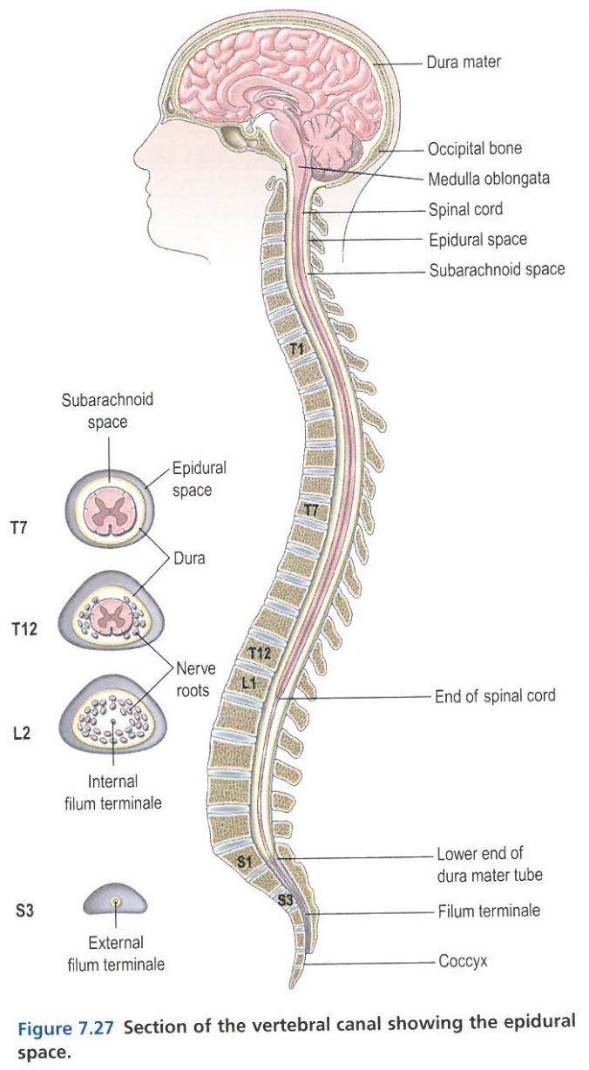
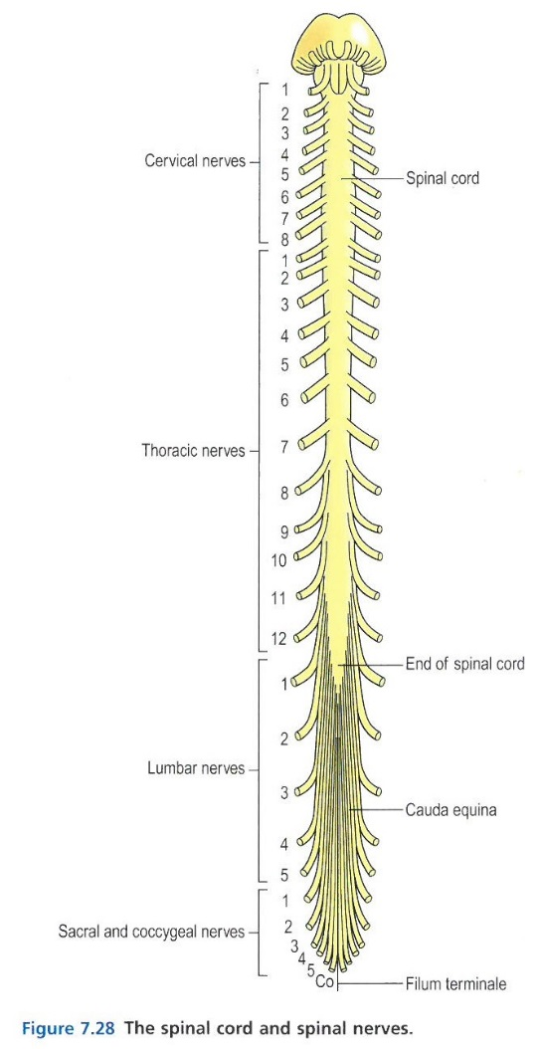
The Peripheral Nervous System
The spinal chord is the elongated,
almost cylindrical part of the CNS
suspended in the vertebral canal
and surrounded by the extended
meninges and CSF.
The diagram on the right shows the extension of the PNS via the Cranial Nerves (12 pairs) and the Thoracic or Spinal Nerves (31 pairs).
The PNS also contains the autonomic nervous system,
of particular interest to us in terms of its sympathetic
and para-sympathetic functions.
The PNS is primarily composed of sensory nerve fibres,
for transmission of electrical impulses between the
receiving nerves, the CNS (in particular the Brain),
and the effector organs (i.e. the resulting physical
action).
Seeing the stimulus > cognitive > response on more
than the physical level, and considering that all is
energy, whether an electrical impulse or an emotion,
we start to understand that the PNS and CNS are the
key systems through which we experience and interact with the world around us.

Slide 18
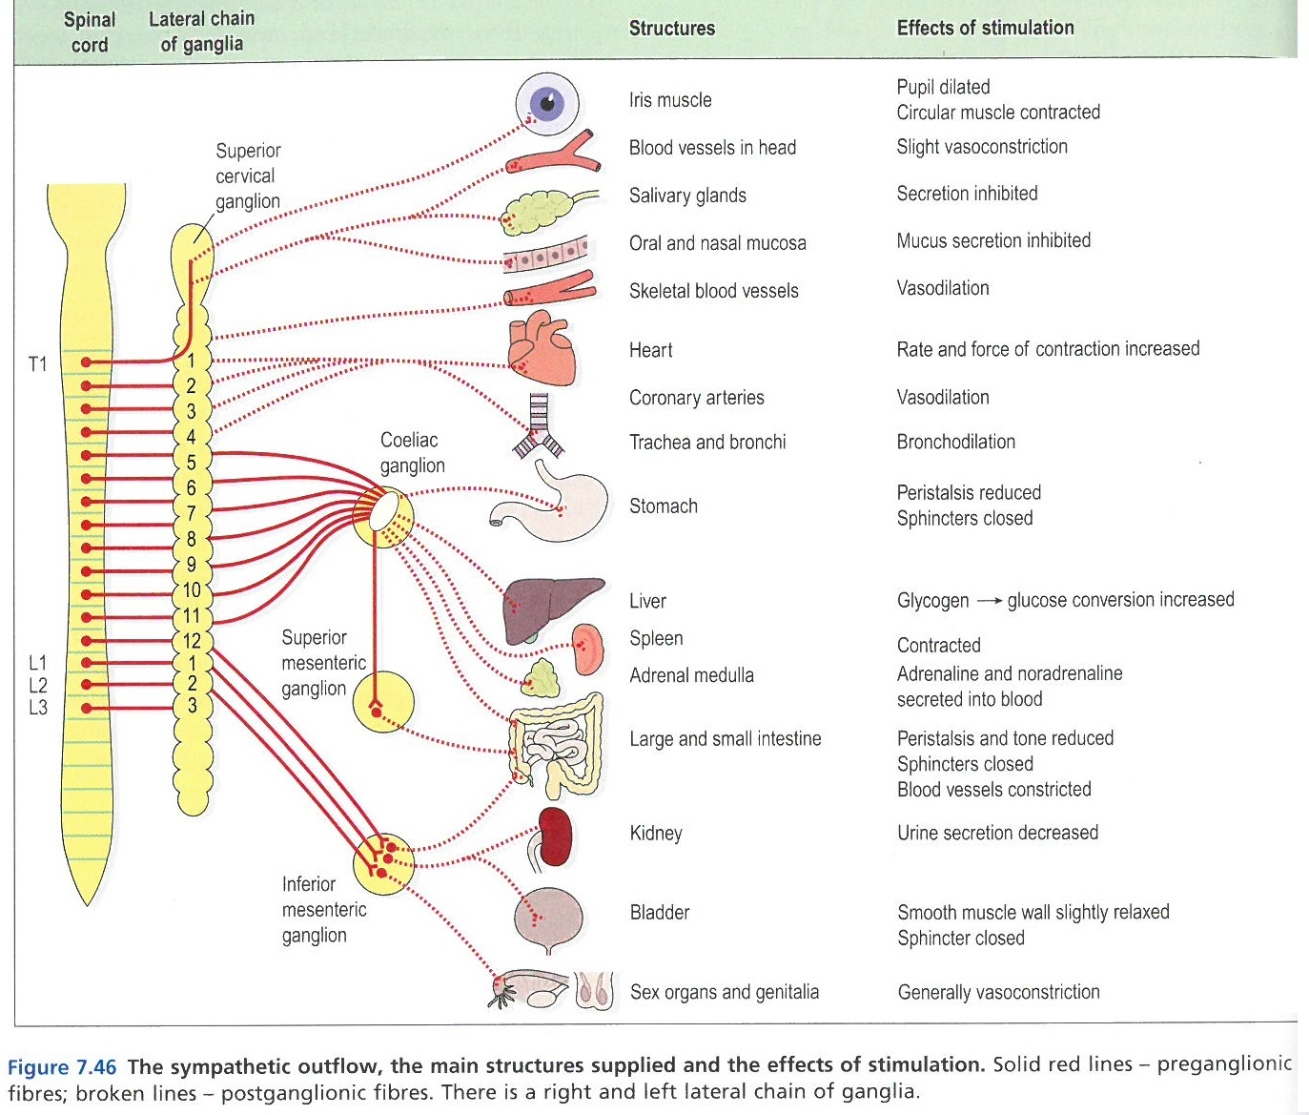
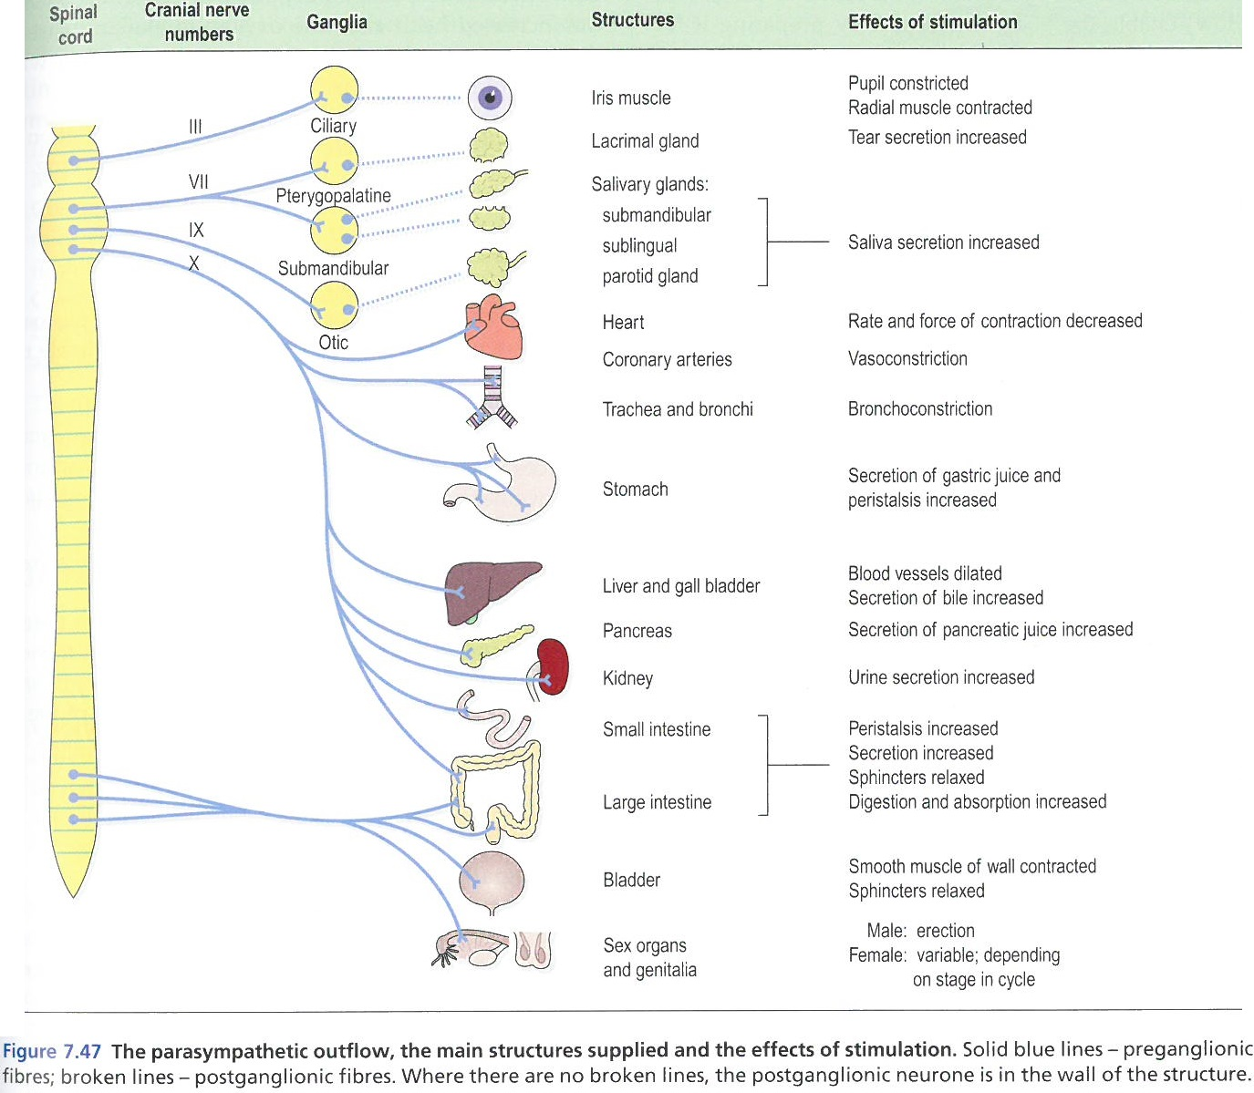
The Peripheral Nervous System

Slide 19
Dis-ease in the Brain and Nervous System
The free-flow of energy throughout the brain, the CNS and PNS results in an ease of internal communication between ALL sub-systems and organs. A block, disruption or derangement of this intricate energetic flow however has important symptomatic impact on the individual, as the Nervous System as a whole (Brain, CNS, PNS) is the critical core of human interaction with our earthly environment. Some of the key conditions that arise from such as change in the healthy energetic state are:
Increased Cranial Pressure such as from a haematoma (pocket of bleeding), a haemorrhage (free-flow bleeding), hydrocephalus (build-up of CSF) or a mass (e.g. tumour). In homeopathy we also consider causes such as emotional pressure (stress, worry, anxiety), and toxicity in the CSF, the meninges or the CNS tissues, restricting the usual free-flow state.
Head Injuries
Inflammations and Infections such as meningitis, encephalitis, herpes, polio, rabies, HIV and CJD.
Epilepsy or other non-specific cerebral seizures
Unconsciousness resulting from trauma
Damage to the brain tissue resulting in reduced brain function or a complete shut-down (vegetative state).
Cerebral hypoxia (interruption to the blood and oxygen supply to the brain)
Stroke (cerebrovascular disease)
Cerebral infarction (thrombosis or blockage of the blood vessels)
Dementia (degeneration of the cerebral cortex), including Alzheimer’s, Huntington’s.
Parkinson’s Disease (degeneration of neurones)
External toxins such as chemicals and environmental poisons causing damage to specific or various cells.
Demyelinating diseases such as MS
Spinal Chord diseases such as Motor Neuron Disease, degeneration or compression of the spinal chord.
Tumours, fragmenting and displacement of the vertebrae.
Neuropathy (typically of the PNS) – various inflammatory conditions
Guillain-Barre Syndrome – acute inflammatory polyneuropathy
Bell’s Palsy – compression of facial nerves, causing inflammation and oedema
Spina Bifida – congenital malformation of the neural tubes and spinal chord
Tumours, slow-growing, rapid growing, benign or malignant, metastases (spread).

Slide 20
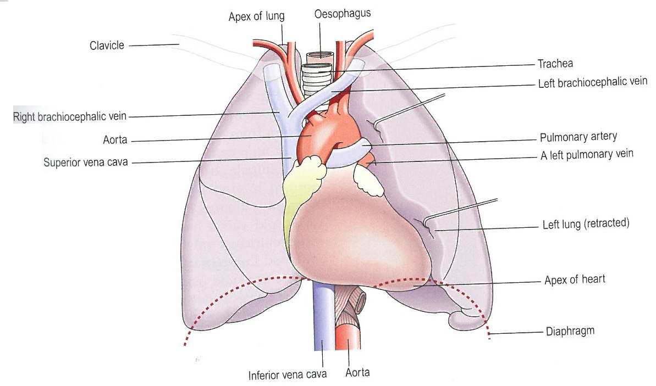
Cardiovascular System, incl. Blood
Healthy blood consists of –
45% blood cells (red – erythrocytes, white – leukocytes, and platelets - thrombocytes),
55% plasma (proteins, electrolytes, nutrients, waste, hormones and gasses)
Red blood cells are produced by the bone marrow, and are responsible for haemoglobin and oxygen.
Each person has certain antigens (protein responsible for the immune function) on their red cell surfaces, denoting their particular blood type: A, B, AB or O. The latter is the universal donor type.
White blood cells make up only 1% of the blood cells volume and are responsible for the immune response. An increase in the white cells count is therefore evident when the body is responding to disease such as an infection.
Platelets are also derived from the bone marrow when stimulated by a hormone released by the kidneys, and are responsible for clotting (i.e. the cessation of bleeding).
Whilst blood is produced by the bone marrow, it is circulated by the heart’s pumping action, through a network of arteries, veins and capillaries throughout the body.
In doing so, we encounter blood pressure – the measurable pressure that results from the movement of the blood through the tubes, and the pulse. Now, let’s consider the heart and its surrounding organs:
Thymus
Heart

Slide 21
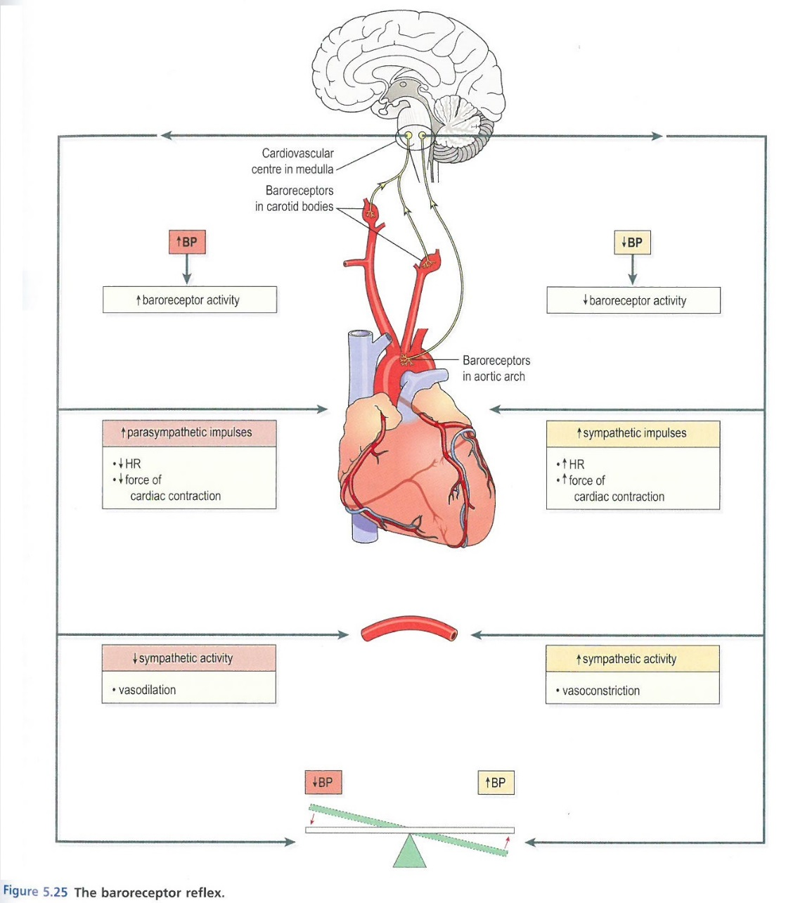
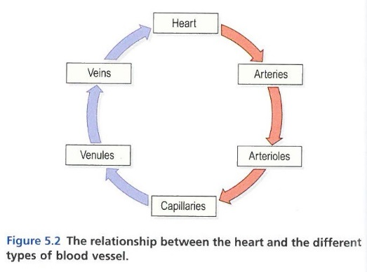
Cardiovascular System, incl. Blood
The heart pumps blood through five types of blood vessels: the arteries for outflowing blood, diffusing and narrowing to the arterioles and then to the capillaries from where tissues are fed with oxygen, nutrients and other blood constituents necessary for healthy function. Once delivered, the blood cells return via the capillaries, to the venules and ultimately the veins, back to the heart. The above is referred to as systemic circulation. From its return to the heart, the blood enters the pulmonary circulation where it is pumped to the lungs for re-oxygenation and returns, fully loaded, to the heart to resume it’s systemic phase.
The heart rate, measured in beats per minute, is primarily affected by gender, autonomic nerve activity, age, hormone circulation, activity, temperature, baroreceptor reflex (pressure and stretch) and emotional states. This is interesting from a homeopathic viewpoint, as a holistic consideration of these factors relate to nearly all states of ill health we observe in clients.

Slide 22
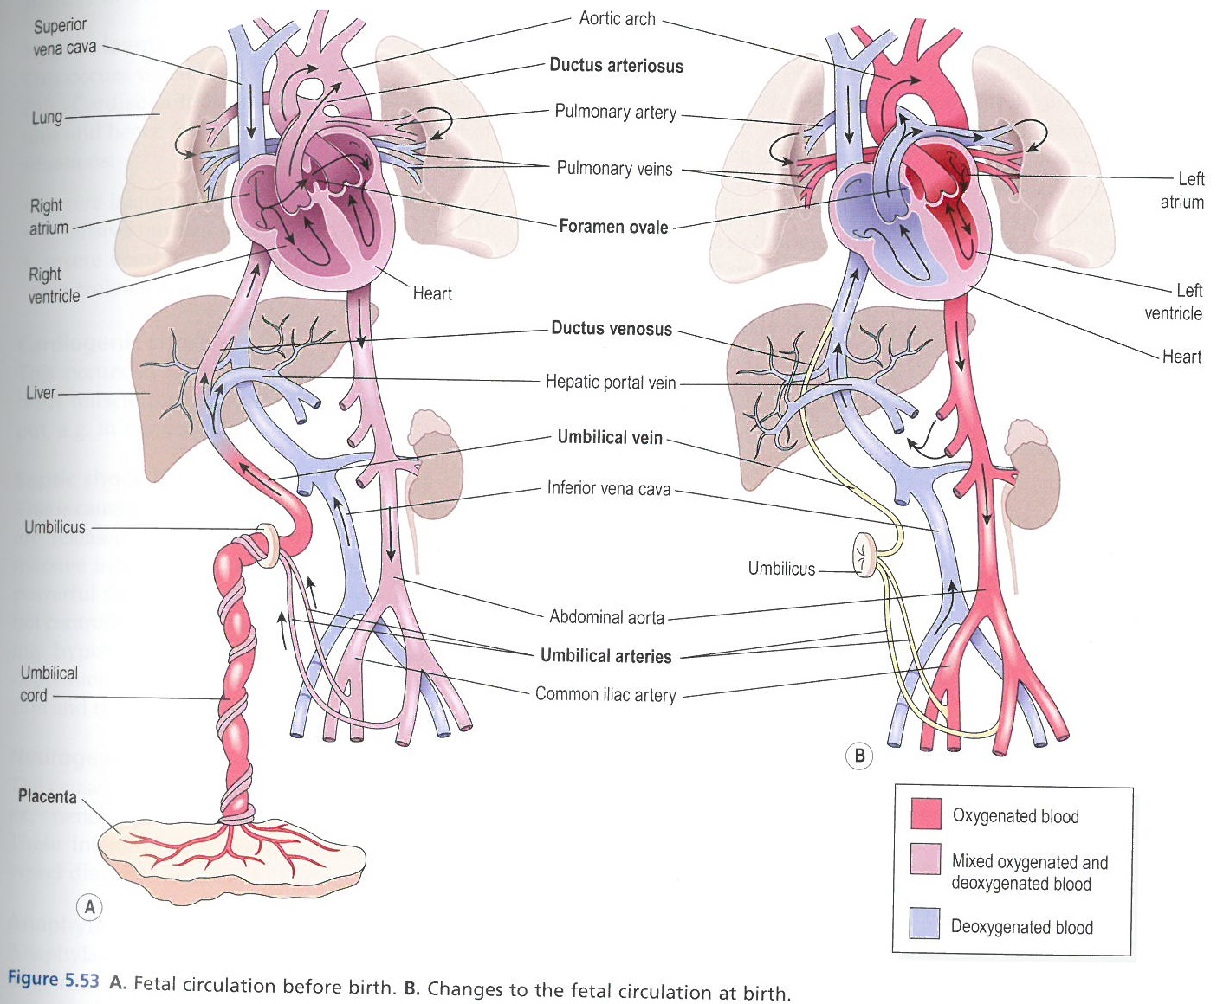
Cardiovascular System, incl. Blood
Foetal circulation changes dramatically at the moment of their first breath – when their own respiratory system activates and their own blood circulation separates from that of the mother’s. The increase in oxygen levels from the first breath onwards, triggers heart valve and blood circulation changes, resulting in the cessation of chord pulsing, i.e. the inflow and outflow of blood via the umbilical chord. This leaves parents with a decision on when to cut the chord – before, or after the pulsing has ceased.

Slide 23
Dis-ease of the Cardiovascular System
Interruption or disruption of the cardiovascular system has a dramatic impact on the health of the person – either temporarily or permanently. Many people live with chronic conditions however acute cardiovascular disease is also the cause of many deaths. Some of the major conditions observes in the cardiovascular system are:
Shock – hypovolemic shock or loss of vital fluids, heart muscle shock (heart attack), septic shock (septicaemia, bacteraemia, endotoxic), neurogenic shock (nerval symptoms), anaphylactic shock (hormonal systems)
Anaemias (insufficient levels of haemoglobin and oxygen) – various types denoting the particular impairment or lack.
Polycythaemia – increased red blood cells thickening the blood.
Leukocyte disorders – increases, decreases or malignancy
Haemorrhagic diseases – thrombosis (insufficient platelets), Vit K deficiencies (reduced clotting function), DIC (disseminated intravascular coagulation – thickening of blood > clots)
Congenital disorder such as haemophilias (“bleeders”) – carried by the female but presented in the male.
Thrombosis (blood clot) and Embolism (mass of material carried in the blood stream e.g. part of a thrombus)
Blood vessel pathology such as atheroma (fatty plaque in arteries), arteriosclerosis (degeneration of arteries), aneurysm (localised dilation of the arterial wall), varicose veins (dilation of the vein wall), thrombosis, tumours
Oedema (in tissues), including ascites (in cavities) and effusions (in pleural cavity) – accumulation of excess fluids.
Heart failure – failure to maintain sufficient circulation.
Heart valve disorders – slackness, inability to close or regurgitation.
Ischaemic heart disease – narrowing or blockage of arteries typically by plaques.
Rheumatic heart disease – auto-immune, inflammatory condition of the connective heart tissue (often seen following strep throat), pancarditis, pericarditis, endocarditis
Arrhythmias – disturbances in the heart rhythm.
Congenital abnormalities – malformations and at-birth dysfunction in ventricles, valves, arteries, veins, tissues.
Hyper- and Hypotension (blood pressure irregularities)

Slide 24
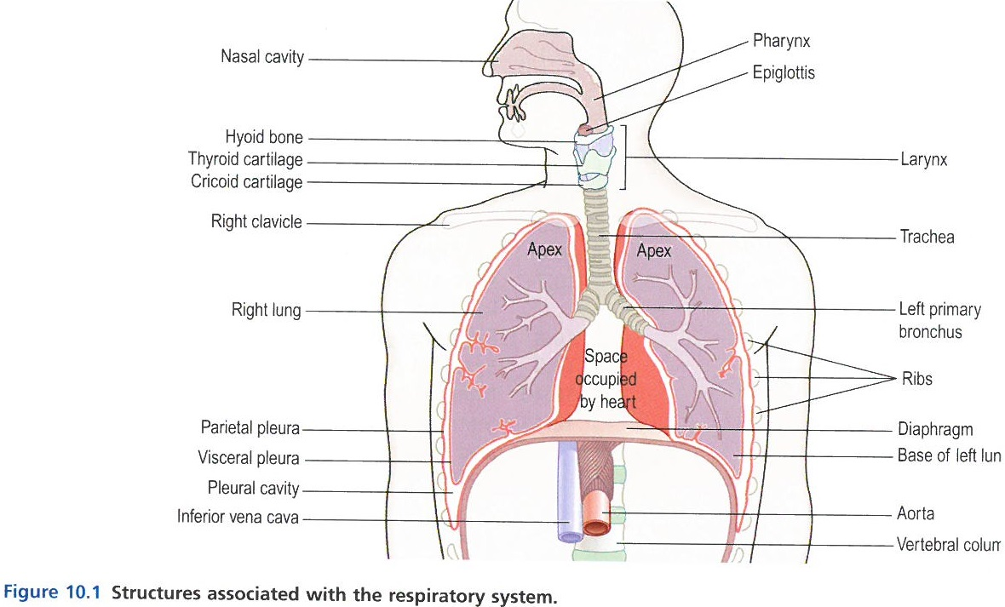
Respiratory System
The respiratory system consists of the nose, pharynx, larynx, trachea, bronchi (one bronchus per lung), bronchioles & alveoli, two lungs and their coverings, the pleura.
The nose warms, filters and cleans the air, and humidifies it on inhale. The nose is also responsible for the sense of smell.
The pharynx is an ever narrowing tube of mucous membrane, sub-mucosal tissue and smooth muscle tissue that is the passage way for both air and food. In terms of respiration, it also warms and humidifies the incoming air. Its other key functions relate to nerval activity relating to taste and hearing, muscle activity relating to speech and immune activity relating to anti-body production via the tonsils.
The larynx (voice box) consists of cartilage, ligaments and membranes and has multiple cartilage structures variously responsible for blocking off the passage during swallowing, preventing inhalation of foreign objects, housing the vocal chords, aiding in the production of audible sound, protection of the lower respiratory tract, as well as further humidifying, filtering and warming of incoming air.
The trachea (windpipe) consists of three layers of cell tissue, c-shaped cartilage rings, membranes and connective tissue. It allows further passage of clean, warm, humid air into the bronchia and also mucociliary escalation of particles upwards as part of the coughing reflex.

Slide 25
Respiratory System
The lungs are two large, cone-shaped organs essentially functioning as fluid-lined balloons. The pleura cover the pleural cavity filled with serous fluid whilst the lung cavity contains the bronchi, bronchioles & alveoli responsible for harvesting oxygen and other necessary gasses from the air intake.
The rib cage protects the lungs whilst the diaphragm acts as a bellows to take in and expel air into and out from the lungs.
Lung tissue itself consists of cell tissue, smooth muscle and tendons, which allow expansion and contraction as air is inhaled and exhaled.
The lung functions are of course, broadly speaking, that of controlling air intake and exhalation, warming and humidifying the air, oxygenating the blood, exchanging various gasses, incl. oxygen, with the blood stream (e.g. exhaling CO₂) and also to protect against infection via the presence of blood cells (as per section on cardiovascular system).

Slide 26
Dis-ease of the Respiratory System
A free-flow of clean air through the Respiratory System results in a smooth exchanges of vital gasses between the environment and the blood stream. Interference with either the respiratory system or the air quality can result in health issues, or the respiratory system may be the energetic position in which a block is expressed in the form of infection. Some common dis-ease conditions are:
Infections and Inflammation, incl. colds, influenza, sinusitis, allergic rhinitis (hay fever), tonsillitis, pharyngitis / laryngitis / tracheitis, diphtheria, bronchitis, pneumonia, abscesses and tuberculosis
Tumours in the respiratory tract or lungs.
Obstructive disorders such as emphysema (degeneration of connective lung tissue), asthma (spasmodic mucal and muscle enlargement narrowing breathing pathways), bronchiectasis (dilation of the bronchi and bronchioles associated with bacterial infection), cystic fibrosis (abnormally viscous secretions from all glands).
Restrictive disorders such as pneumoconiosis (restricted breathing caused by external particle pollutants such as coal dust, agricultural fibres, moulds & fungi, or asbestos), chemically induced disease (poisons, cytotoxic drugs e.g. chemo, oxygen administration e.g. in ICU)
Lung collapse (atelectasis) due to obstruction, inability to fully expand the lung (e.g. premature babies), pressure or hypoventilation (failure to re-inflate).

Slide 27
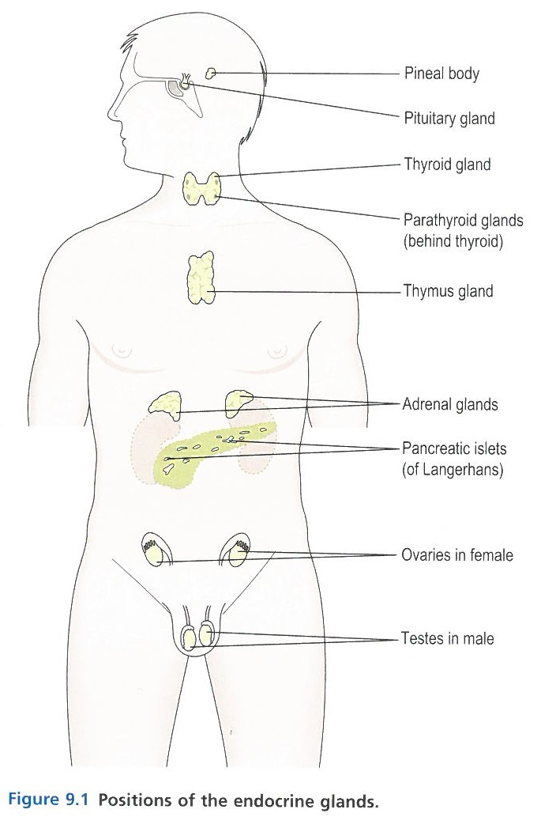
Endocrine System
The Endocrine System consists of a number of secretory glands, without a physical connection however from a homeopathic viewpoint, a strong energetic connection via the chakra & nadi system.
These glands are referred to as ductless glands, as their hormonal secretions diffuse directly into the bloodstream for delivery to the target tissues and organs.
These hormones are the “instructions” issued to the tissues and organs for onward cellular development and metabolism.
General health is maintained partly by the autonomic nervous system and partly by the endocrine system, with a strong, respective correlation to what is often called the flight/flight response and the rest/develop state. I.e. the autonomic nervous system drives the rapid responses whilst the endocrine system drives the slower, more precise adjustments.
On reaching target cells, hormones act as a switch influencing either metabolic or chemical processes in the cell, e.g. oxytocin released during labour kick-starts contractions. The effects are also non-physical, e.g. serotonin release influences the level of happiness or depression experienced. On a spiritual level the “rainbow bridge” connecting the pineal and pituitary glands facilitates God Consciousness.
& surrounding Hypothalamus
Placenta during pregnancy

Slide 28
Endocrine System
The Pituitary Gland and the Hypothalamus act as a unit, regulating the activity of most of the other endocrine glands.
The Anterior Pituitary lobe is responsible for the Growth Hormone, Thyroid Stimulating Hormone, ACTH, Prolactin (breastmilk) and Gonadotrophins (sex hormones).
The Posterior Pituitary lobe is responsible for Oxytocin and ADH (urine function).
The Thyroid is responsible for Thyroxine (T₄) and T₃ (normal growth and development of skeletal and nervous systems).
The Parathyroid is responsible for parathormone which regulates the increase of calcium in the blood when required, such as when bone-destroying cells are present.
The Adrenals consist of the Adrenal Cortex and the Adrenal Medulla. The former is responsible for various corticosteroids needed in metabolism regulation and responses to stress, as well as androgens (sex hormones). The latter, the Adrenal Medulla, is developed from the sympathetic nervous system (structurally) and produces adrenalin (epinephrine and norepinephrine).
The Pancreatic Islets (Islets of Langerhans) are clusters of ductless glands distributed throughout the pancreas and are separate from the exocrine pancreas which produces pancreatic juice. The Islets are responsible for Insulin (which reduces blood glucose levels) and Glucagon (which increases blood glucose levels). It further secretes GHRIH, as does the hypothalamus, which inhibits secretion of both Insulin and Glucogon.
The Pineal Gland is responsible for Melatonin production which is optimal in complete darkness and therefore, like all cyclical hormone secretions, closely tied to the body’s circadian rhythms. Many nerves do physically connect the Pineal Gland to the hypothalamus, and this may well lead to allopathic acknowledgement of the Rainbow Bridge.
The Thymus Gland, via its hormone Thymosin, is responsible for T-lymphocytes, activated lymphocytes that originate from stem cells in the red bone marrow and through this Thymus’s activation process, triggers the ability for the mature T-lymphocytes to distinguish “self” cells and tissues from foreign ones, through an ability to distinguish between millions of antigens. The Thymus Gland is therefore of paramount importance to the Immune System.
Outside of the Endocrine Glands, other tissues secrete specific hormones triggering local processes: histamine, serotonin, prostaglandins, gastrointestinal hormones.

Slide 29
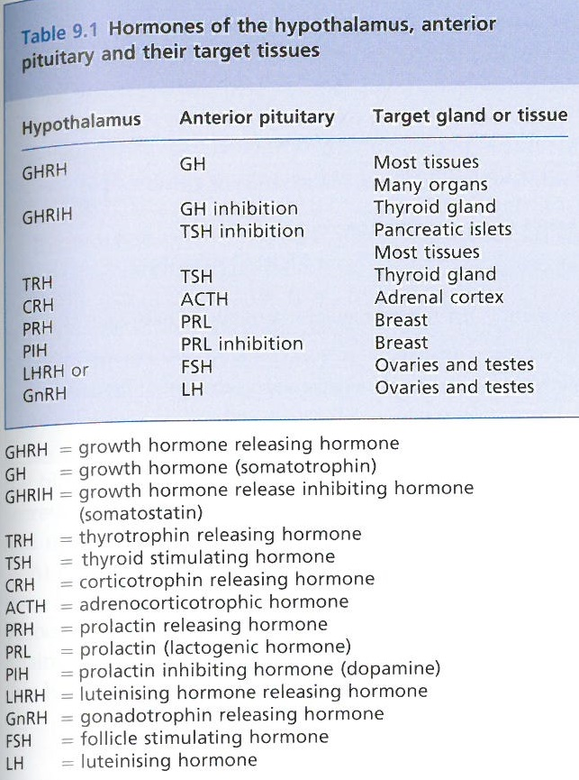
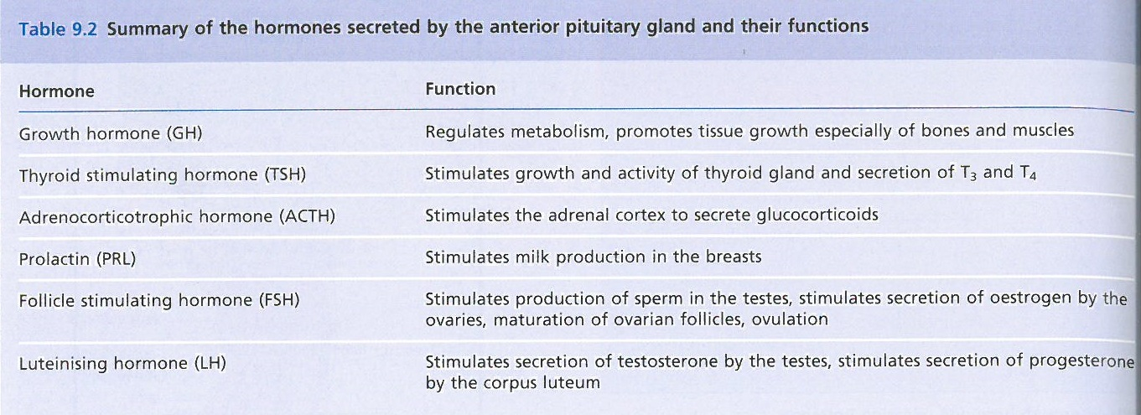
Endocrine System

Slide 30
Dis-ease of the Endocrine System
Endocrine disorders are commonly related to tumours or auto-immune conditions, and typically somatise as either over or under secretion of hormones.
Gigantism and Acromegaly (large extremities).
Dwarfism and Fröhlich’s Syndrome (underdevelopment)
Hyperprolactinaemia (over-production of breast milk (men & women), cessation of menses and sterility).
Ischaemic Necrosis (hypotensive shock through sudden drop in BP)
Hyper- and Hypothyroidism (hyperactive metabolism and underactive metabolism respectively). Hyperthyroidism can result in outwardly noticeable symptoms such as goitre (though this can present without hyperthyroidism), or exophthalmos (bulging eyes). Hypothyroidism (Hashimoto’s) can be outwardly observed as cretinism in children (now called Congenital Hypothyroidism) and Myxoedema in adults (accumulation of polysaccharides under skin).
Tumours.
Tetany (hypocalcaemia)
Cushing’s syndrome (a myriad of physical symptoms traced back to distortion of the ACTH hormone production)
Addison’s Disease (a myriad of physical symptoms traced back to distortion of the adrenocortical hormone production)
Diabetes – generally a deficiency or absence of insulin, or more rarely an impairment in the uptake of insulin.
Type 1 – insulin dependent – typically congenital or following severe illness where natural insulin production is severely affected
Type 2 – non-insulin dependent – 90% of cases; insulin secretion is either above or below normal range and results in flow-on effects often undiagnosed. Heavily lifestyle and health related.
Secondary – develops as a concomitant to acute or chronic pancreatitis, certain allopathic drugs (steroids, phenytoin, diuretics), following on from other primary endocrine derangements,
Gestational – raised plasma glucose levels during pregnancy; may naturally revert to normal post-partum however often recurs later in life. Linked to heavier than normal babies, stillbirths and SIDS.
In severe situations, diabetics experience a range of concomitant conditions and in an acute situation, may fall into a diabetic coma. Chronic complications typically include cardiovascular disturbances, recurring infections, renal failure and blindness.

Slide 31
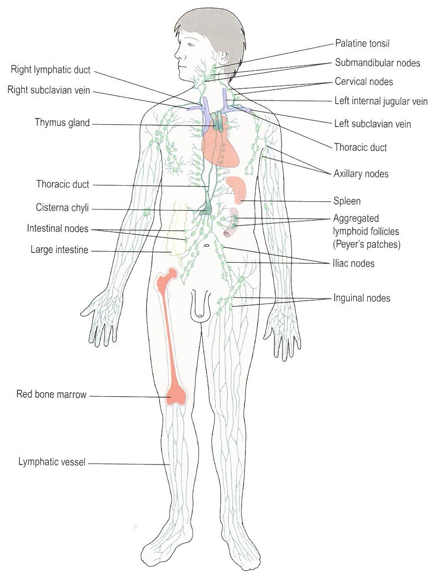
Lymphatic System
Each cell of the body is bathed in interstitial (tissue) fluid, which diffuses constantly from the blood stream into the capillaries. Whilst some fluid remains in capillary system the rest diffuses further into the Lymphatic System, forming Lymphatic Fluid (lymph). Lymph travels through the Lymphatic System, include the lymph nodes, before returning again to the blood.
Healthy lymph is a clear, straw-coloured fluid with slight viscosity akin to glycerine.
The Lymphatic System is defined by function and therefore we’ll observe an overlap in constituent parts, e.g. the Thymus Gland is part of both the Lymphatic System and the Endocrine System. The Lymphatic System consists of the lymph, lymph vessels, lymph nodes, lymph organs (spleen & tonsils), lymphoid tissues (e.g. inside nodes & tonsils) and the bone marrow.
The key functions of the Lymphatic System are:
Tissue drainage of excess fluids by the lymphatic vessels
Absorption of nutrients in the small intestine by means of the lymphatic vessels
Maintaining a healthy immune system by means of lymphatic organs such as spleen and thymus.

Slide 32
Lymphatic System
The primary purpose of the Lymphatic System is that of cleaning - it is a comprehensive drainage system that transports waste particles through and out of the body. The lymphoid tissue such as tonsils or that found inside the lymph nodes, acts as a sophisticated filter that traps particulate matter such as bacteria, microbes, cells from malignant tumours, worn-out or damaged cell tissue, and inhaled particles.
By the time lymph has passed multiple lymph notes, the resulting fluid is typically clean before re-entering the blood stream. In cases where the clean-up is incomplete, you may observe the slight hardening and enlargement of the lymph node, indicating stuck energy and the likelihood of inflammation or infection. The anti-bodies found in each lymph node is the first line of defence in these cases and a rise in white blood cells will be present.
The spleen is the largest lymphatic organ and is responsible for safely destroying unwanted and abnormal materials, storage of an emergency volume of blood that can be instantly released into the blood stream and lymphocyte proliferation during times of acute infection.
The Thymus, though part of the Endocrine System, also has a lymphatic role in its content of lymphoid tissue and T-lymphocyte production.
Throughout other locations in the body there are further lymphoid tissue not enclosed by a capsule such as the outer lining of the spleen or thymus, but instead associated by mucosa. These are referred to as groups of MALT (mucosa-associated lymphoid tissue) and instead of filtering lymph, their role is that of sentries on the look out for invaders from outside – early detection and defence near the main sites exposed to the outer world. Examples are the tonsils and the Peyer’s patches in the small intestine and those in the genitourinary tract.

Slide 33
Dis-ease of the Lymphatic System
Some particles are not phagocytosed (cell eating – consumed and destroyed) completely, and may lead to complications in the Lymphatic System.
Tumour fragments may remain and multiply, forming a new tumour in the lymph node.
Infectious particles or tissues may infect node after node, eventually making it through into the blood stream.
Lymphadenitis (infection of the lymph nodes)
Lymphangitis (inflammation of lymph vessels)
Lymphadenopathy (enlargement of lymph nodes)
Splenomegaly (enlargement of the spleen)
Lymphoedema (swelling following obstructed lymphatic drainage)
Lymphatic obstructions such as tumours, accumulated particles, surgical removal of lymph nodes.
Infectious Mononucleosis (“Mono” / Glandular Fever) – viral infection
Lymphoma – malignant tumours (Hodgkin’s or Non-Hodgkin’s)
Malignant Metastases – spreading tumours
Splenomegaly – spleen enlargement typically secondary to a primary infection, circulatory disorder, blood disorder or malignancy.
Enlargement of the Thymus Gland, typically secondary to a primary auto-immune condition such as Myasthenia Gravis, Addison’s or Hyperthyroidism.

Slide 34
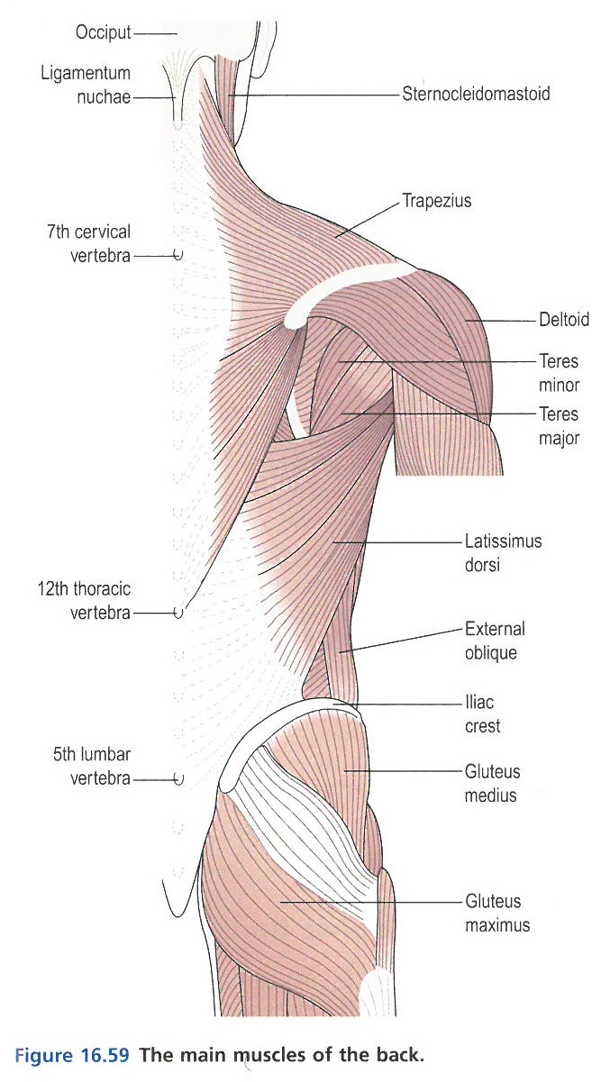
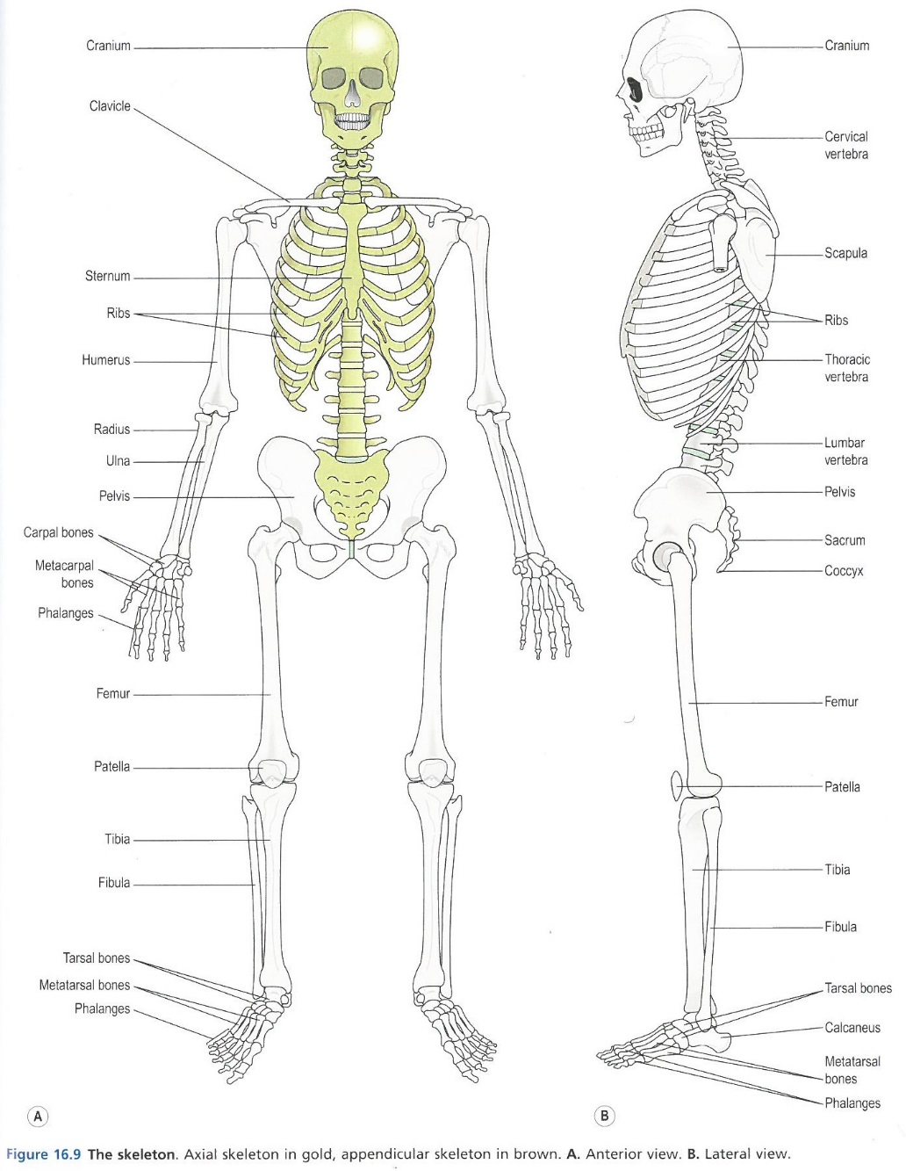
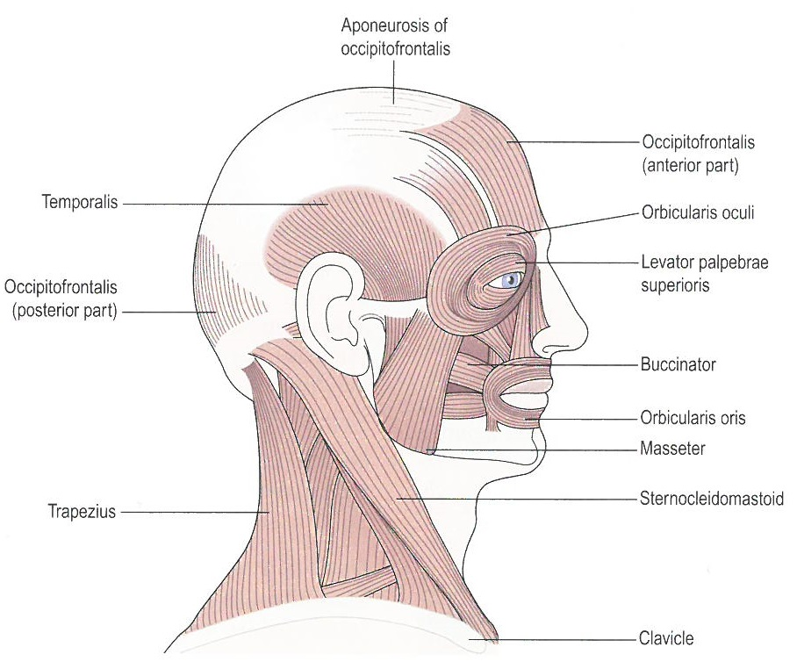
Musculoskeletal System
The Musculoskeletal System comprises bones, the axial and appendicular skeletons, joints (fibrous, cartilaginous and synovial), muscle tissue, tendons and ligaments. In its totality, it is a framework for the body, allows movement, is responsible for haemopoiesis (production of blood cells in the red bone marrow) and mineral storage.

Slide 35
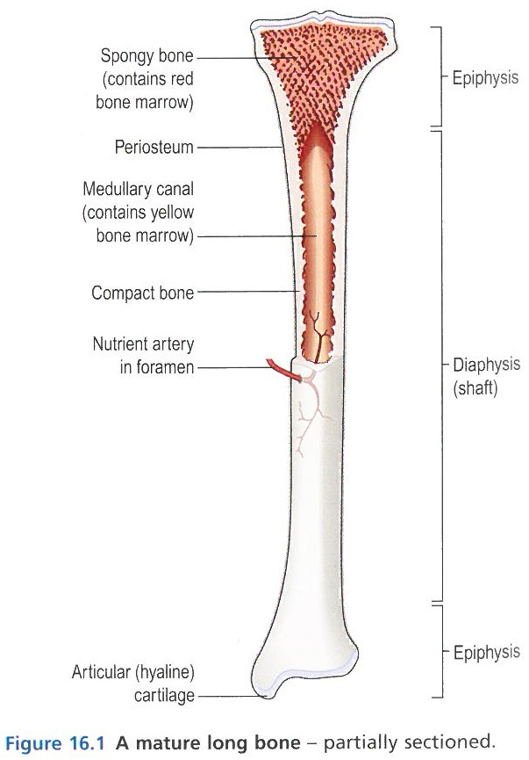
Musculoskeletal System
The bones in the body are classed as long, short, irregular, flat and sesamoid bones, and totals 270 bones at birth, decreasing to 206 bones by adulthood after some bones have fused together. Development of bone tissue, called osteogenesis or ossification, starts in utero and completes only at 21 years of age.
Though each type of bone will have a somewhat varied structure, the long bone depicted in the diagram opposite shows the main composition.
Joints, muscles, tendons and ligaments allow and facilitate movement of the skeleton.
Fibrous joints allow little or no movement, such as the joints between the skull bones (called sutures), the periodontal ligament holding a tooth into the mandible, or the interosseous membrane holding the tibia and fibula together. These fibrous joints stabilise the alignment between bones and absorb jolts, without allowing too much movement.
Cartilaginous joints contain a pad of fibrocartilage that acts as a shock absorber; in some cases it allows no movement such as in development of the long bones in children where the shaft and bone end are held in place by this strong fibrocartilage whilst ossification takes place. In other cases the cartilaginous joints allow limited movement such as in the spine, where the vertebrae are separated by the intervertebral discs.
Synovial joints allow for space between articulating bones, holding them together by a sleeve of fibrous tissue, lubricated by synovial fluid. Most synovial joint allow a range of movement.

Slide 36
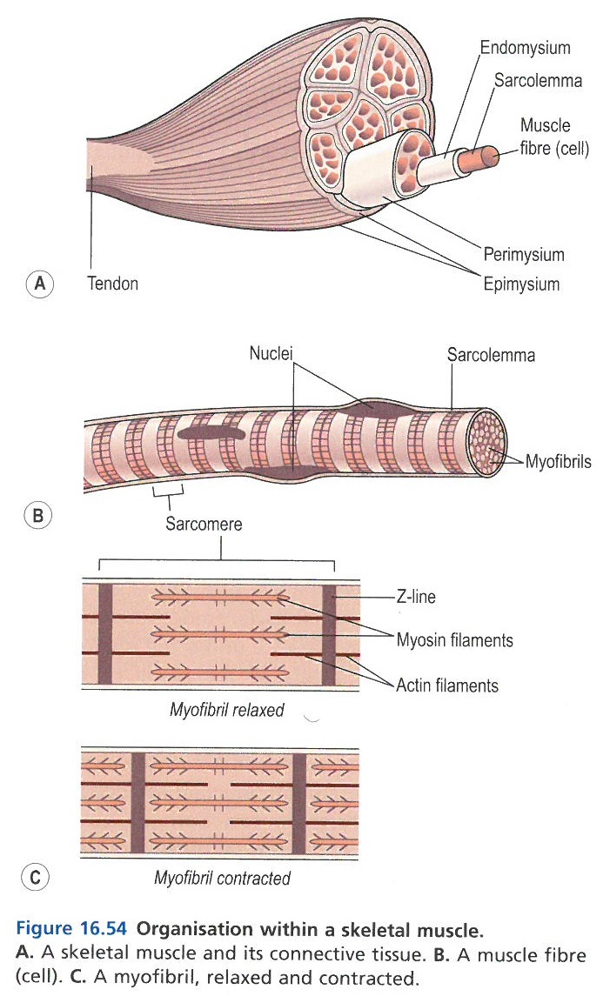
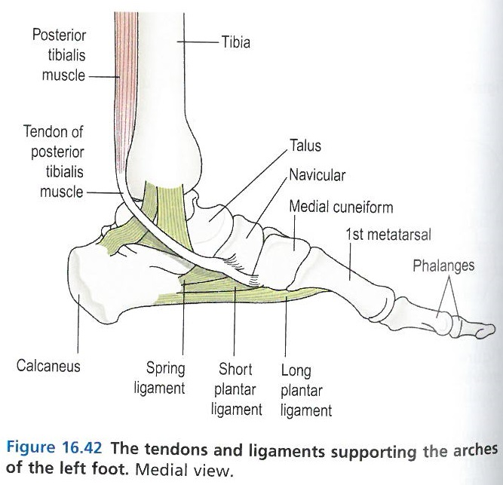
Musculoskeletal System
Muscle tissue, tendons and ligaments – also referred to as the soft tissues of the skeletal system – provide power, agility and dexterity to the body. There are 640 skeletal muscles (320 bi-lateral pairs) in the adult body, however grouping and definition of what is one muscle vs parts of a muscle, varies such that some sources cite up to 850 muscles. As with bones, there are different types of muscles such as –
cardiac muscle, found only in the wall of the heart,
skeletal muscle (also called a voluntary muscle) over which we exercise conscious control. These muscles are attached to the bones via tendons, and are used to move the skeleton.
visceral muscles (also called involuntary muscles or smooth muscles), and are found in various structures such as the walls of blood vessels, the uterus, the bladder, gastrointestinal tract, the iris of the eye, and numerous other functions over which we do not need to exercise conscious control.
Tendons are similar to ligaments; both are made of collagen. Ligaments join one bone to another bone, while tendons connect muscle to bone. Figure 16.42 shows an example of bone, muscle, tendon and ligament connectivity in the foot.

Slide 37
Dis-ease of the Musculoskeletal System
Lifestyle choices, medications such as steroids, diseases and congenital factors may result in poor formation or degeneration of the musculoskeletal system. Key conditions are listed below:
Osteoporosis – reduction in bone density resulting in bone pain, fractures and skeletal deformity.
Paget’s Disease – abnormal remodelling of bone, with soft, malformed bone deposits resulting in fractures and deformities.
Rickets & Osteomalacia – inadequate mineralisation of the bone, resulting in bowing and deformity in children and osteomalacia in adults, resulting in fractures and bone pain.
Osteomyelitis – bacterial infection of the bone, typically a concomitant following surgery, injury or a blood disorder.
Abnormalities of bone development – achondroplasia (stunted growth, dwarfism), brittle bone syndrome (defective collagen synthesis resulting in failure of ossification and spontaneous fracturing).
Tumours – benign or malignant, e.g. Osteosarcoma (rapid growing, often metastatic).
Arthritis (Inflammatory Joint Disease) – rheumatoid, ankylosing spondylitis, Psoriac arthritis, Reiter’s Syndrome, Rheumatic Fever, Infective arthritis.
Trauma & Injury – sprains, strains, dislocations, penetrating injuries, fractures (healing can be slowed by tissue or foreign fragments being present between bone ends, by deficient blood supply, poor alignment of bone ends, continued mobility in bone ends, infections, age, systemic illness, drugs such as steroids, malnutrition).
Osteoarthritis – non-inflammatory degeneration of the articular cartilage, leading to bone rubbing and damage, leading to effusion and inflammation in a chronic state.
Gout – acute inflammation due to sodium urate deposits, resulting from reduced or impacted urate excretion.
Connective tissue diseases such as Lupus, Scleroderma and others, that affect multiple systems containing connective muscle tissue.
Carpal Tunnel Syndrome – compression of the median nerve as it passes through the wrist’s carpal tunnel, resulting in pain & numbness in the thumb, index and middle fingers.
Myasthenia Gravis – auto-immune condition resulting in blockage of nerve impulses to muscles.
Muscular Dystrophies – progressive degeneration of groups of muscles.
Crush Syndrome – sustained pressure resulting in large-scale muscle necrosis, which in turn, on release of pressure, allows necrotic toxins to enter the blood stream causing infection or septicaemia.

Slide 38
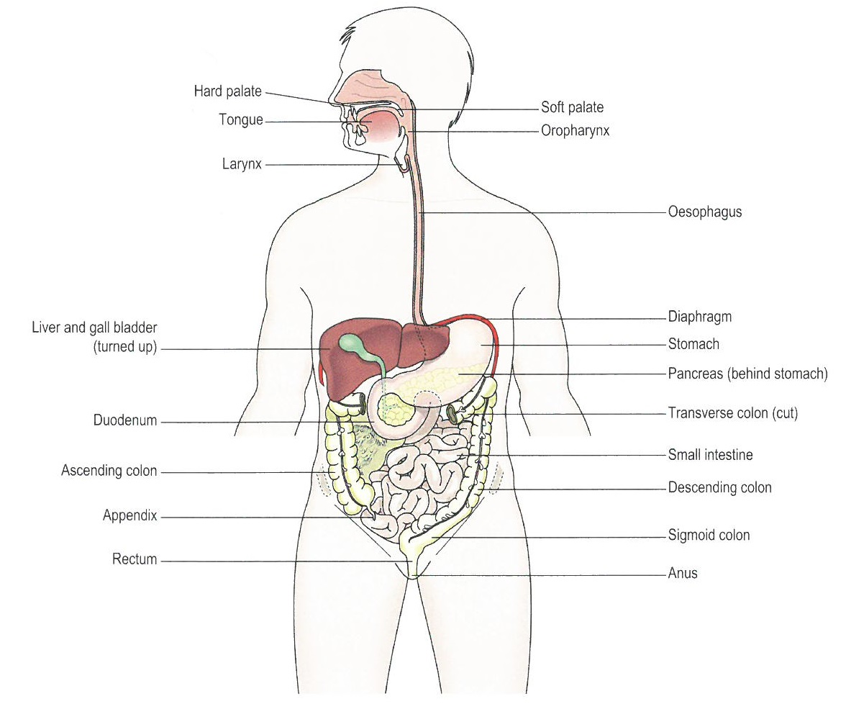
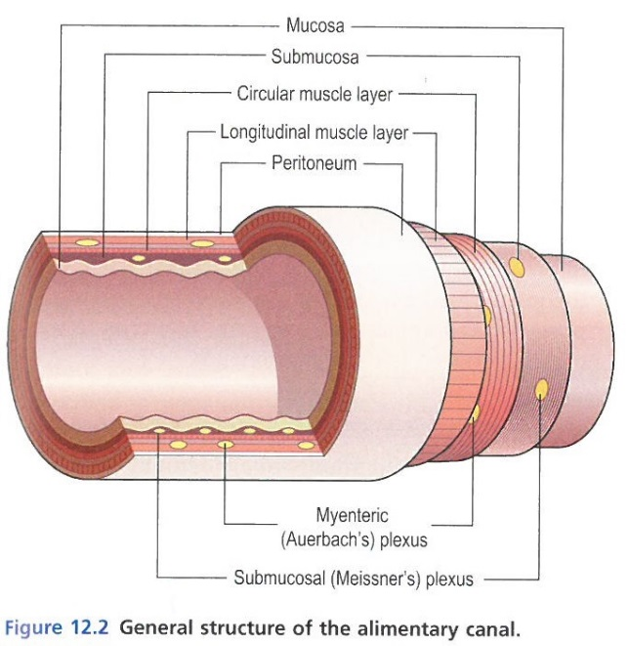
Gastrointestinal System
The Gastrointestinal System, or Digestive System, is the collective name covering the alimentary canal, its associated “accessory” organs and the various digestive processes that take place. The main functions of the Digestive System are ingestion (via mouth), propulsion (via thorax), digestion (via abdomen), absorption (via pelvis) and elimination (via anus).
The alimentary canal (gastrointestinal tract) consists of the mouth, pharynx, oesophagus, stomach, small intestine, large intestine, rectum and anal canal. Although each part has its place and function, they general structure is remarkably similar.
The accessory organs comprise three sets of salivary glands, the pancreas, the liver and biliary tract.

Slide 39
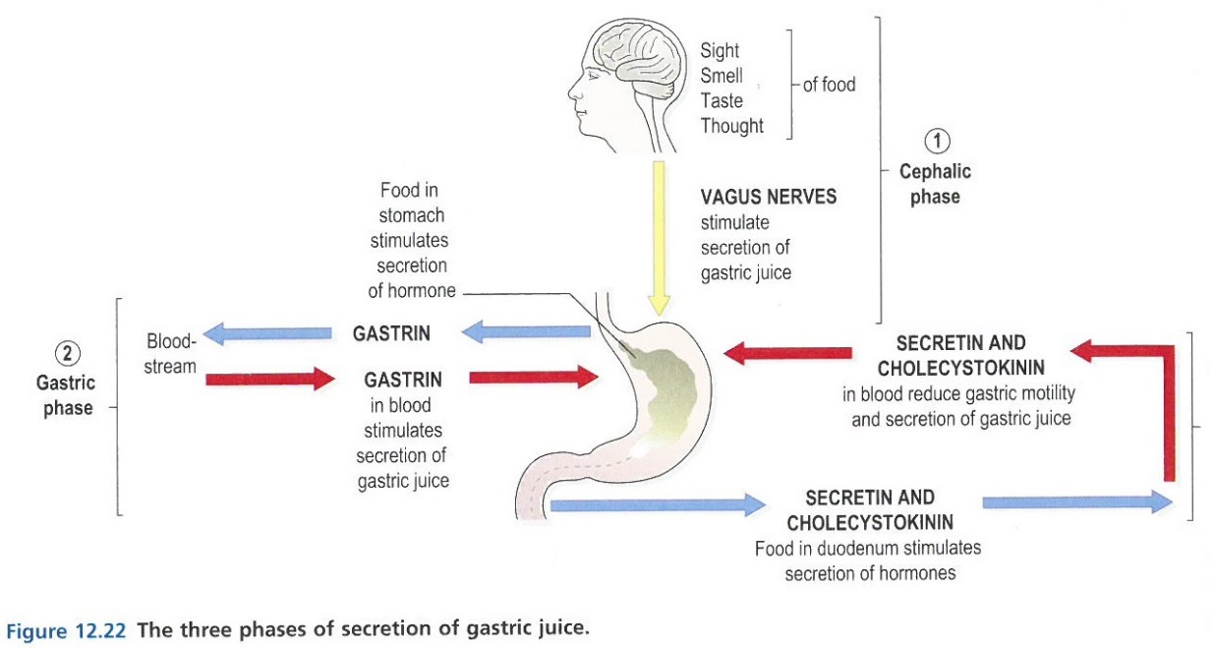
Gastrointestinal System
Once food enters the stomach, digestions starts with a release of gastric juices which serve to aid the mechanical and chemical breakdown of food, and prepare it for onward propulsion to the small intestine. The stomach serves as temporary storage whilst the initial breakdown occurs, facilitates limited absorption of water, alcohol and certain drugs and also forms an initial defence against microbes and gastric irritants (by means of hydrochloric acid). The vomiting reflex may be employed to expel undesirable content. The stomach also prepares iron and B₁₂ for use later in the digestive process and when ready, pushes the broken-down food through the pyloric sphincter into the small intestine.
The small intestine is just over 5m long and connected to the large intestine by the ileocaecal valve. The small intestine, with help from secretions from the gallbladder (bile) and pancreas (pancreatic juice), and peristaltic movements stimulated by the parasympathetic nervous system, secretes intestinal juice to complete the chemical breakdown of the food and digestion of carbohydrates, fats and proteins. As the digestive process progresses, these nutrients are absorbed through the intestinal wall and passed into the blood stream. Lymph follicles step in as immune defence against any microbes that survived the stomach’s digestive juices. A the digested food reaches the end of the small intestine, peristatic movement pushes it through the ileocaecal valve into the large intestine.
The large intestine is approximately 1.5m long and its primary functions are –
Final absorption of nutrients, water, mineral salts and vitamins,
Healthy microbial activity to help break down waste and synthesise products such as Vitamin K and Folic Acid,
Mass movement of the waste towards the rectum,
Defaecation (involuntary in infants).

Slide 40
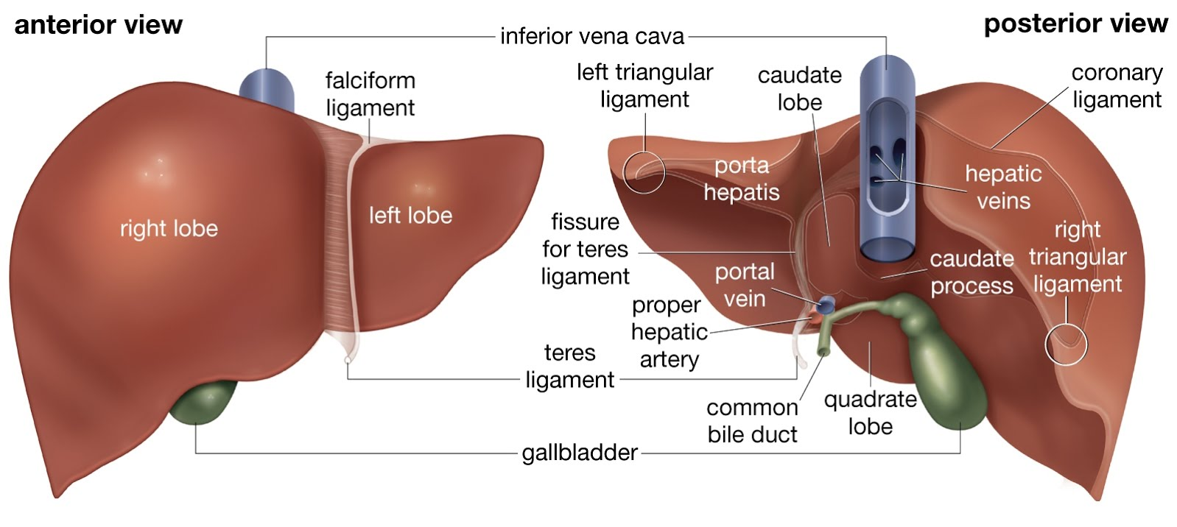
Gastrointestinal System
A special mention for the Liver:
The Liver is an organ of huge importance in the defences of our bodies, as well as metabolism of nutrients. Once digested and absorbed through the digestive tract, many nutrients are sent to the liver for onward metabolism (i.e. chemical reaction utilising the nutrient to provide energy). The liver is very active and in TCM it is the major organ in which Yin/Yang balance is sought. Key liver functions from a physical perspective are:
Carbohydrate metabolism
Fat metabolism
Protein metabolism
Defence against microbes
Detoxification of drugs and toxic substances
Inactivation of hormones
Production of heat
Secretion of bile
Storage of vitamins A, D, E, K and B₁₂, and minerals iron and copper
Storage of glycogen

Slide 41
Dis-ease of the Gastrointestinal System
Mouth – Thrush, Angular Cheilitis, Gingivitis, Apthous Stomatitis, Herpes infections (cold sores or gingivostomatitis), Squamous Cell Carcinoma, congenital disorders such as cleft palate, cleft lip, dental caries.
Pharynx – tonsillitis, diphtheria.
Salivary Glands – mumps, calculi (stones), tumours (adenoma, carcinoma).
Oesophagus – varices (dilation of vein walls), inflammation, infection (oesophagitis), achalasia (inability to swallow), tumours (95% malignant), congenital abnormalities such as narrowing or openings.
Stomach – gastritis, peptic ulceration, tumours, pyloric stenosis.
Intestines – appendicitis, typhoid fever, salmonella infections, E-coli food poisoning, staphylococcal food poisoning, clostridium food poisoning, campylobacter food poisoning, antibiotic-associated diarrhoea, cholera, dysentery, gastroenteritis, inflammatory bowel disease (which includes Crohn’s and ulcerative colitis), diverticular disease, tumours, hernias, volvulus (obstruction), intussusception (obstruction), intestinal obstruction, malabsorption (which includes Coeliac and Tropical Sprue).
Pancreas – pancreatitis, cystic fibrosis, tumours.
Liver – hepatitis (A, B, C), toxicity, cirrhosis, liver failure, tumours.
Gallbladder – gallstones, cholecystitis, cholangitis, tumours, jaundice.

Slide 42
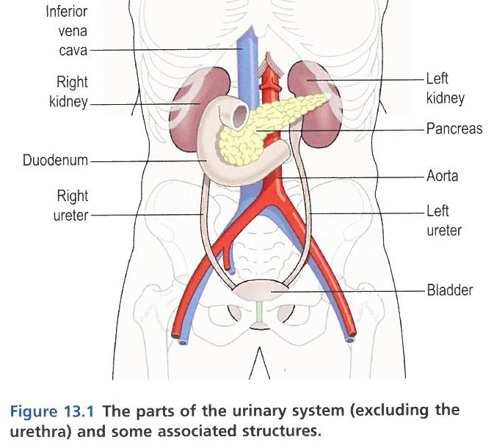
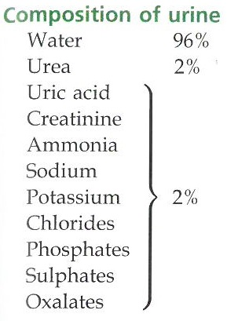
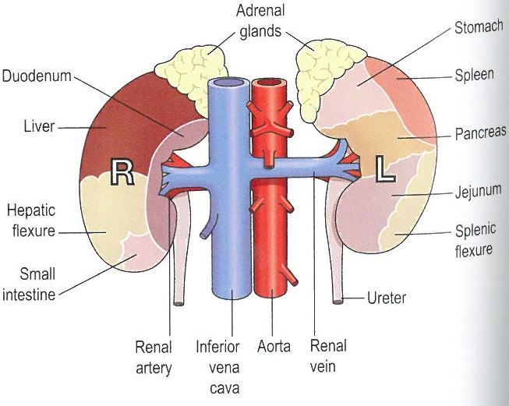
Urinary System
The Urinary System is the main excretory system and comprises two kidneys (for urine secretion), two ureters (to convey urine to the bladder), the bladder (for temporary storage or urine), and the urethra through which urine passes out of the body (during process of micturition, or urination).
The urinary process is key to maintaining healthy water and electrolyte levels in the body, and excreting metabolic waste such as urea, uric acid and excess ions.
The kidneys are responsible for –
The formation and secretion of urine, which in turn regulates total body water, electrolyte (sodium, potassium, calcium) and acid (pH) balance
Filtration & selective reabsorption nutrients.
The production and secretion of erythropoietin, the hormone that stimulates production of red blood cells, and
The production and secretion of renin, an enzyme important to the control of blood pressure.

Slide 43
Dis-ease of the Urinary System
The kidneys have a significant functional reserve, meaning that they will continue to perform under great pressure, and often pathology is not observed until more than one kidney’s function is lost. The major pathologies observed are:
Glomerulonephritis (GN) – various inflammatory and non-inflammatory conditions affecting the kidney tissue. The most well-known being nephritis (kidney infection).
Nephrotic Syndrome – various symptomatic presentations within the kidneys and associated functions, typically part of several kidney diseases.
Diabetic Nephropathy – renal failure caused by diabetes.
Hypertension – as either the precursor or concomitant of kidney disease.
Pyelonephritis – bacterial infection.
Reflux Nephropathy – reflux of urine from the bladder to the ureter.
Renal failure – sudden and severe reduction in filtration rate and kidney function.
Acute Tubular Necrosis (ATN) – damage to the tubular cells typically from ischaemia or nephrotoxic substances.
Renal calculi – renal colic (small stones), staghorn calculi (large stones) – too large to pass causing obstruction.
Congenital abnormalities – ectopic (misplaced) kidney, polycystic disease
Tumours – renal cell carcinoma, nephroblastoma.
Obstruction to outflow – hydronephrosis, spinal lesions (nerve damage)
UTIs (urinary tract infections) – ureteritis, cystitis, urethritis
Incontinence – stress, urge, overflow

Slide 44
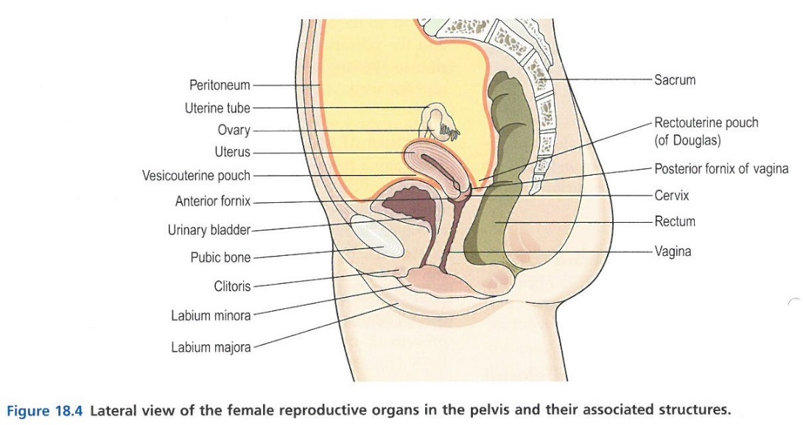
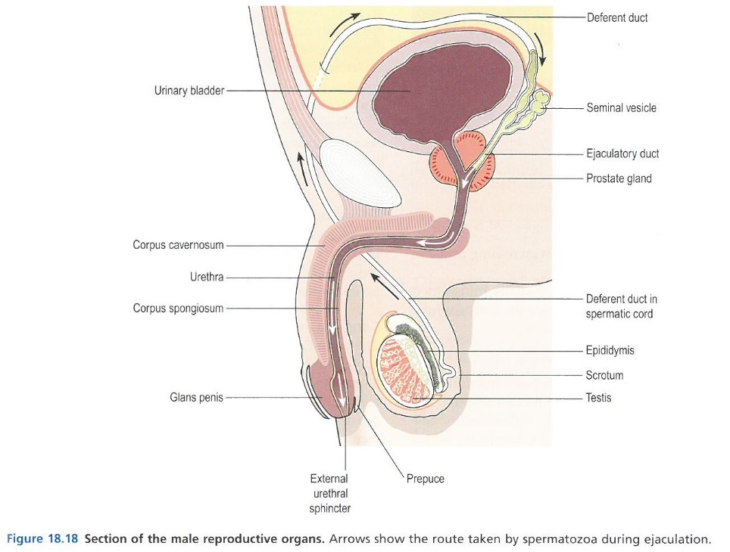
Reproductive System
The ability to reproduce is unique to living organisms, and sexual reproduction denotes a separation between female and male organs and the need for both in order to procreate. In mammals, males produce spermatozoa and female, ova, which are the gametes (reproductive germ cells) in which genes are carried on chromosome structures. Through this genetic material inherited characteristics are passed down the generational line, and this we will discuss in more detail in Module 3.
Gametes contain only 23 chromosomes, which upon fertilisation, fuses with the other gamete’s 23 chromosomes, resulting in the full compliment of 46 chromosomes arranged into 23 pairs, as found in all body cells. This fertilised egg (zygote) embeds into the uterine wall for a 40-week gestational period prior to birth.
The functions of the female reproductive system are: formation of ova (ovulation), reception of spermatozoa (sperm), providing suitable environments for fertilisation and foetal development, parturition (childbirth), and lactation (provision of breast milk).
The functions of the male reproductive system are: production of spermatozoa, transmission of sperm to the female.

Slide 45
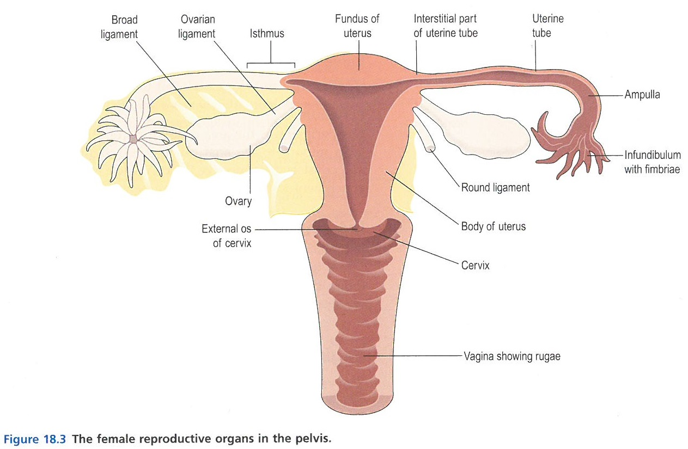
Female Reproductive System
The female reproductive system consists of the external genitalia, or vulva, which comprises the labia, clitoris, hymen (incomplete mucous membrane covering the opening to the vagina), vestibular/Bartholin’s glands (moistens the vulva with mucus), blood, lymph and nerve supplies, and the perineum.
The female reproductive system furthermore consists of the internal genitalia, comprising the vagina, uterus, uterine tubes and ovaries.
Allopathy is largely concerned with the structure and position of reproductive organs, whereas homeopathy is primarily concerned with the FLOW of fluid and emotions through these structures.
Blockages in either physical or emotional flow will soon become troublesome, resulting in a variety of ailments.
Similarly, trauma to the reproductive system is also traumatising to the heart, throat and third eye chakras, often resulting in physical, emotional and mental pathology.
Notes:
The hymen is what is “tested” in virginity testing.
The pain and/or bleeding that some women experience when the hymen is first broken, relates to the rigidity and viscosity of the membrane and its adhesion to the surrounding tissue.
The vestibular/Bartholin’s glands are often affected during menopause or times of stress, when vaginal dryness becomes an issue for some women.
The internal genitalia are typically those affected by tumours and surgeries such as hysterectomies.

Slide 46
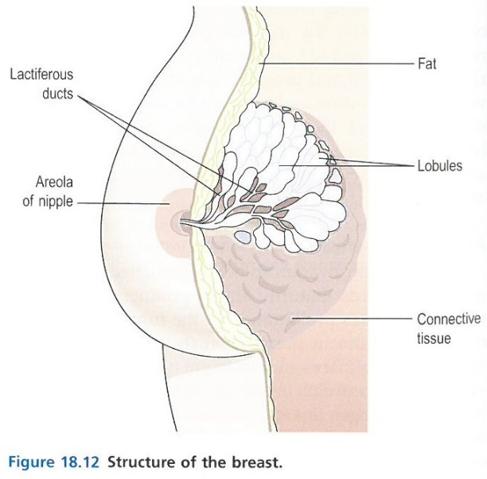

Female Reproductive System
Puberty denotes a time during which the internal reproductive organs reach maturity and full functionality (on a physical level). For girls, this is typically between the ages of 12 and 14, and marked by the menarche (beginning of the child bearing phase – lasting approx. 36 years).
With stimulation from the Follicle Stimulating Hormone (FSH) and Luteinising Hormone, the ovaries start releasing ova which are formed during the girl’s own gestational phase in utero, and stored in the ovaries until menarche.
During this time, the breasts develop and enlarge, as the lactation function matures.
The typical ovulation cycle is 26 to 30 days in length, meaning the time between release of an ovum from alternating ovaries.
Without fertilisation, the menstrual flow consists of the unfertilised ovum, secretions from the endometrial glands, the endometrium cells (the layer that is shed if no zygote has embedded for development), and blood from the degenerating capillaries not needed to support the endometrium. Typically the menstrual flow lasts about 4 days.
Notes:
The hymen is what is “tested” in virginity testing.
The pain and/or bleeding that some women experience when the hymen is first broken, relates to the rigidity and viscosity of the membrane and its adhesion to the surrounding tissue.
The vestibular/Bartholin’s glands are often affected during menopause or times of stress, when vaginal dryness becomes an issue for some women.
The internal genitalia are typically those affected by tumours and surgeries such as hysterectomies.

Slide 47

Male Reproductive System
The male reproductive system consists of the scrotum, divided into two compartments each of which contains one testis, one epididymis (coiled tube that stores sperm and transports it from the testes) and the testicular end of the spermatic chord.
The testes are glandular structures equivalent to the female ovaries, and are responsible for production and secretion of testosterone from puberty onwards (typically between ages 10 and 14), as well as production and transport of spermatozoa.
Production of the latter is also managed by FSH, as for ova release in females.
Sperm is produced (spermatogenesis) typically at 3 degrees C below normal body temperature, a fact helped by the scrotum’s location outside of the body.
Spermatozoa consist of a head, body and whip-like tale, used during propulsion to the ovum (sperm motility).
The spermatic chords suspend the tested in the scrotum, and each chord contains an artery, veins, lymphatics, nerves and the deferent duct, which passes up to the posterior wall of the bladder, where it joins the duct from the seminal vesicle, to form the ejaculatory duct.
Notes:
The hymen is what is “tested” in virginity testing.
The pain and/or bleeding that some women experience when the hymen is first broken, relates to the rigidity and viscosity of the membrane and its adhesion to the surrounding tissue.
The vestibular/Bartholin’s glands are often affected during menopause or times of stress, when vaginal dryness becomes an issue for some women.
The internal genitalia are typically those affected by tumours and surgeries such as hysterectomies.

Slide 48
Male Reproductive System
Seminal fluid accounts for 60% of ejaculation fluid, and contains nutrients to support the spermatozoa on their journey through the female reproductive system.
The ejaculatory ducts (2) pass through the prostate gland, which, on ejaculation, secretes a thin, milky fluid containing a clotting enzyme to thicken the resulting seminal discharge, increasing the likelihood of the semen being retained close to the cervix. This accounts for approx. 30% of the ejaculated volume, with the remaining 10% being spermatozoa.
The male reproductive system furthermore consists of the urethra and penis.
The urethra allows for the flow of both semen and urine, whilst the penis firstly encases the urethra and secondly becomes engorged and erect to facility sexual intercourse with the female.
During puberty, males experience significant muscle and bone growth, enlargement of the larynx and deepening of the voice (breaking voice), hair growth, skin thickening, enlargement of the penis and scrotum and maturation of the seminal ejaculation process.
Although there is no direct male equivalent to female menopause, fertility and virility decreases slowly with age as testosterone secretion declines typically from the age of 50 onwards.
Notes:
The hymen is what is “tested” in virginity testing.
The pain and/or bleeding that some women experience when the hymen is first broken, relates to the rigidity and viscosity of the membrane and its adhesion to the surrounding tissue.
The vestibular/Bartholin’s glands are often affected during menopause or times of stress, when vaginal dryness becomes an issue for some women.
The internal genitalia are typically those affected by tumours and surgeries such as hysterectomies.

Slide 49
Dis-ease of the Reproductive System
STDs (Sexually Transmitted Diseases (infections)), such as Chlamydia (cervical inflammation causing Pelvic Inflammatory Disease (PID)), Gonorrhoea (infection of the mucosa of reproductive and urinary tracts; can also spread to other internal genitalia), Syphilis (infection that can pervade genitalia, lymphatics, skin and mucosal membranes, bones, nervous system and brain), Vulvovaginitis (often a concomitant of gonorrhoea and can spread to cause PID), Candidiasis, AIDS, Hepatitis B, Genital Herpes/Warts (HPV) and Non-specific Genital Infection.
Vulvar dystrophies (thinning of tissues and formation of fibrous tissues, predilection to infections and sometime becoming malignant)
Imperforate hymen (deformation where membrane is complete instead of incomplete, allowing menstruation to take place).
Cervix disorders such as dysplasia (dysplastic) where tissue thickens and can process to abnormal cell proliferation (malignant) and cervical carcinoma. Often seen as a concomitant to HPV infection.
Uterine & uterine tube disorders such as endometriosis (growth and retention of this tissue inside and outside of the uterus), endometritis (non-specific infection), adenomyosis (growth of the endometrium), endometrial hyperplasia (enlargement of the endometrium, often turning malignant), Leiomyoma (fibroid, myoma – typically benign fibrous tumours), endometrial carcinoma.
Ovarian & uterine tube disorders such as Acute Salpingitis (uterine tube inflammation), Ectopic pregnancy (implantation of a fertilised ovum outside the uterus, typically in the uterine tube), ovarian tumours and cysts (benign, malignant or metastatic).
Infertility – male and female – resulting from blockages, anatomical abnormalities, glandular and/or hormonal abnormalities, endometriosis, anorexia or severe malnourishment.
Breast disorders such as mastitis (breast inflammation), tumours (benign or malignant), cysts, gynaecomastia (breast tissue development in men)
Penial infections such as balanitis.
Urethra infections such as gonococcal urethritis, cystitis (bladder infection), urinary tract infections (UTIs).
Epididymis & Testes infections such as non-specific epididymitis, orchitis (testicular inflammation), often present following surgeries.
Undescended testes (cryptorchidism).
Hydrocele (scrotal swelling)
Testicular tumours (typically malignant)
Prostate Gland infections (prostatitis), fibrosis, enlargement (benign) and malignant tumours.
Erectile dysfunctions with or without ejaculatory dysfunction.

Slide 50

Sensory System
The physiological sensory system comprises Sight, Sound, Smell, Taste and Touch, whilst holistically we also include Intuition in our Sensory System (often referred to as the 6th sense). Some modalities even extend the Sensory System to a 7th sense, representing the connection with Source. All sense are intimately connected to both the CNS and ANS, and therefore we inherently include the nervous system in our observation and assessment of pathology in any of the senses. Up to 80% of our perception comes from our senses, with specialised nerve endings receiving and communicating directly to the brain for interpretation and response.

Slide 51


Sensory System – Sight
The eyes are our organs of sight, and resting in the orbital cavities are connected to the CNS by the 2nd cranial nerve. Unlike the ears, much of the eyes’ activities are paired in order to provide joint complex function such as three-dimensional vision, depth perception and judgement of speed and distance.
The walls of the eyes are structured into three layers: the outer sclera and cornea, the vascular layer of choroid, ciliary and iris, and the inner nervous tissue layer containing the retina. The eyeball itself contains the lens, aqueous fluid and vitreous gel, which gives the eyeball its shape.
The ciliary muscles relax and contract in order to dynamically change the shape of the lens, allowing for near and distant vision. Eye exercises are therefore as relevant to maintaining healthy sight, as exercise is for the rest of the body. Much of modern-day office work practices can be offset by regular exercise for the eyes and changes from artificial to natural light. Recent studies from The London Eye Hospital proposed 3 hours of outside play to maintain healthy sight in children, increased to 5 hours to have a restorative action.

Slide 52


Sensory System – Hearing & Balance
The ear as the organ or hearing and balance, is connected to the CNS by the 8th cranial nerve, which is stimulated by vibrational sound waves. The outer ear collects the sound waves, the middle ear translates these into vibrations passed along to the inner ear, which in turn converts the vibrations into nerve impulses transmitted to the cerebral cortex.
The semicircular canals and vestibule on the other hand, have the role of measuring and feeding back to the CNS, the head’s position in space, thereby allowing us to maintain both posture and balance. This is done through the peri- and endolymph moving within the canals and vestibule, bending the hair cells and thereby stimulating the sensory nerve receptors.

Slide 53

Sensory System – Smell
The nose is our organ of smell and also a passageway for respiration. Specialised olfactory nerve endings, chemoreceptors, communicate with the CNS via the 1st cranial nerve.
Volatile molecules released by all odorous materials, are dissolved into the mucus membranes of the nasal cavity, stimulating the olfactory chemoreceptors therein.
The brain’s temporal lobes in the cerebral cortex receives the communication and interprets the odour.

Slide 54

Sensory System – Taste
Taste, like smell, relies on chemoreceptors stimulated by molecules dissolved in saliva. Taste buds contain such chemoreceptors and are located in the tongue’s papillae and epithelia, the soft palate, pharynx and epiglottis. These chemoreceptors communicate with the CNS via the 7th, 9th and 10th cranial nerves and the chemical messages are interpreted by the parietal lobe of the cerebral cortex.
Whilst well-described tastes such as sweet, sour, salty and bitter are evident, there are now thought to be many, many more tastes and it is now widely held that any tastebud can register these myriad of tastes.
The sense of taste also triggers the release of gastric juices for digestion, and can trigger a protective gag or vomit reflex in the case of spoilt food.

Slide 55


Sensory System – Touch
Our skin is literally the boundary between us and the rest of life, and as a result this organ somatises much of our physical, mental and emotional interactions with our world. Our skin is the largest organ in the body, and has an approximate surface area of 1.5-2m² in adults. Physiologically it helps to regulate body temperature, protects the underlying structures from exposure and injury, and contains nerve endings for sensing pain, temperature and touch. The skin comprises two main layers, the epidermis and dermis, which includes glands (e.g. sweat glands), skin tissue and subcutaneous tissue, as well as hair and nails.

Slide 56


Sensory System – Morality & Intuition
Intuitive Sense – Ajna Chakra
Provides perception beyond ordinary sight
Related to the pineal gland
Minds eye, forming a part of the main meridian, the line separating left and right hemispheres of the body
Moral Sense - Crown Chakra
Centre for deeper connection with ourselves and deeper connection with a force of life that is greater than ourselves
Sense of morality stemming from central connection between self and Source.

Slide 57
Dis-ease of the Sensory System
Below are some of the main physical conditions you’re likely to encounter in clinical practice:
Hearing loss – conductive impairment, otosclerosis, sensorineural impairment, prebycusis
Ear infections – external otitis, otitis media, serous otitis media (glue ear), chronic otitis media
Meniere’s disease
Labyrinthitis
Motion Sickness
Inflammatory eye conditions – styes, blepharitis, conjunctivitis, corneal ulcer
Glaucoma
Strabismus
Presbyopia
Cataracts
Retinopathies
Retinal Detachment
Retinitis Pigmentosa
Eye Tumours
Colour Blindness
Refractive Disorders – myopia (near-sightedness), astigmatism (far-sightedness)
Loss or impairment of smell
Loss or impairment of taste
Cancers of the nose, mouth and tongue
Sinusitis, Rhinitis, Coryza
Post-nasal Drip
Skin infections & inflammations
Necrosis & circulation issues
Pressure ulcers
Burns
Tumours (malignant & benign) & cysts
Warts, moles, nevis, skin tags & birthmarks
Alopecia
Lupus & connective dermal tissue degeneration
Vitiligo
Cuts & Abrasions
Boils, Abscesses & Carbuncles
Sensory Processing issues

Slide 58
Section A: Classroom Instruction
Part iii – Basic Pathological Processes

Slide 59
Homeopathic view of pathology
In Homeopathy we use the term “Pathology” in the same way as everyone else: a condition of dis-ease observable in the physical, mental or behavioural aspects of the client. In allopathy there is a tendency to separate the physical pathology from the mental and emotional pathology and yet again from the behavioural and developmental pathology. Therefore a client may be seeing three or more allopathic practitioners such as their GP, a Psychologist and a Speech Therapist.
As with all things, specialist knowledge in one area or another can at times be both useful and necessary, however from a holistic viewpoint, that’s not where we start. Homeopathy, being a holistic health system, therefore does not separate nor isolate pathology regardless of which body it is observed in. We know that the person is an integrated, organic being functioning concurrently on a physical, energetic and spiritual plane and is in fact an intersection of these, held together and connected through the Vital Force.
That said, we observe as all humans do, the SOMATISATION of symptoms in the form of pathology. Mainly, clients in a good state of physical, mental and emotional health, are not the ones in your practice room. So we observe and analyse the symptoms initially from the presenting somatisation, working our way into the totality of the case from that point on.

Slide 60
Section B: Student Research

Slide 61
Student Research
Following on from your tuition day for this module, please make time to read the following parts from your text books in detail and with care; take the time to look up new words or terminology, research new concepts introduced by the text and also ask questions (your teacher is contactable via email). Although you will not be directly asked to prove your understanding of these parts, it will be assumed that you have read and understood them as you progress onto your next module.
Read “Alternative Practitioners”, Chapter 2 – Philosophy
Read “Alternative Practitioners”, Chapter 3 – Basic Pathological Processes
Read “Alternative Practitioners”, Table 11.2, page 212
Read “Anatomy”, Common Prefixes, Suffixes and Roots, pages xi-xii
Read “Anatomy”, Effects of autonomic stimulation, pages 170-171
Read “Anatomy”, Chapter 11 pages 266-275
Read “Anatomy”, Chapter 13 pages 337-338
Read “Anatomy”, Glossary, pages 459-464
Read “Anatomy”, Normal Values, pages 465-466

Slide 62
Section C: Module Assignment

Slide 63
Module Assignment
Following on from your research, please complete the following two-part assignment, and return your electronic file(s) to RtH by the agreed date, for review and marking.
Should you have any questions about your assignment, please contact your teacher.
Research the term “Homeostasis” and write a half-page commentary on the Homeopath’s view of Homeostasis. Pictures may be used if required, however does not count towards the page length.
Research via the internet or esoteric texts, and list which emotions are linked to each of the following organs: liver, kidneys, stomach, pancreas, spleen, appendix, gallbladder. Please include both “positive” and “negative” emotions for each.
NB: please include a formal Bibliography at the end of your assignment, citing all works referenced in completing your assignment. As works should be referenced using the full published title, author(s) name, version or edition (where applicable), sections and/or pages (where applicable).
NOTE: Please number assignment responses clearly to ease cross-referencing during marking.

Slide 64
Section D: Clinical Practice
NOT APPLICABLE TO THIS MODULE

Slide 65
Section E: Module Feedback
Part i – Student Feedback

Slide 66
Student Feedback
Once you have completed your tuition, research and assignment for this module, please complete the feedback form and return it to your teacher at RtH. Your feedback helps us improve the course for you and subsequent students; please therefore take the time to consider your experience thus far.
Feedback | Rating (Good, Acceptable, Poor) | Please comment to support your rating and provide improvement suggestions.
Module structure: was the module structure easy to understand and follow; did it flow logically and build your understanding as it progressed?
Module content: was the module content informative and useful? Was the content written at a level commensurate with your progress through the course? Was the content comprehensive enough?
Module delivery: was the classroom-based delivery effective and engaging? Were the handouts suitable to support your learning?
Learning outcomes: did the module help you achieve the learning outcomes set out at the start of the module?
Overall module rating: how would you rate this module overall?
General feedback – please add any further feedback comments here. | N/a

Slide 67
Section E: Module Feedback
Part ii – Teacher Feedback

Slide 68
Teacher Feedback
Your teacher will document their review and feedback of your module assignment here.

Slide 69
Module References
This module has referenced published works, in print and on-line, from the following sources:
Anatomy and Physiology in Health and Illness, 11th Edition – Anne Waugh, Allison Grant
The Manual of Conventional Medicine for Alternative Practitioners – Stephen Gascoigne
Wheels of Life – Anodea Judith
www.humananatomybody.info
www.healyourlifeforever.com
www.dictionary.com and www.theasaurus.com
www.Wikipedia.com
www.cranialintelligence.com

